Slide 1


CHICAGO
STYLE
GUIDE
©️ 2025 W.L. Adams Center for Writing/Texas Christian University

Slide 2
TABLE OF CONTENTS
2
D
Key Characteristics…………………………………………….3
Notes and Bibliography (Footnotes)………………….4
Notes and Bibliography (Endnotes)…………………..5
Formatting /Title Page………………………..…………….6
Direct Quotations…………………………………….………7
Block Quotations…..……………………………………….…8
Poetry Quotations…………………………………………….9
Bibliography Page……………………………………………10
Annotated Bibliography…………………………………..11
Illustrations & Figures……………………………………..12
Tables ……………………………………………………………..13
Text Anchors …………………………………………………..14
Book, One Author…………………………………………...16
Book Consulted Online…………………………………...17
Book of Essays, Multi-Authored………………………18
Organization or Agency as Author………………..…19
Peer-Reviewed Journal in Print……………………….20
Peer-Reviewed Journal Online…………………………21
Magazine Article Online…………………………..…...22
Newspaper Article Online………………………..……23
Dictionary or Encyclopedia Online…………….…..24
Dictionary or Encyclopedia with Authors….…..25
Website ………………………………………..……………...26
Blog Post………………………………………………………..27
Podcast…………………………………………………….…...28
Archival Radio Broadcast………………………….......29
Supreme Court Ruling……………………………..…....30
Federal Statute…………………………………….…….….31
Song on a Streaming Platform…………….……….…32
YouTube or Streaming Video…………….…………...33
TED Talk or Webinar…………………………………….…34
Film Screening or DVD……………………..………….…35
Archival Film Online…………………………………….….36
Visual Art Viewed Online…………………………….....37
Archival Photograph……………………………………….38
Historical Map………………………………………………..39
Scriptural Texts……………………………………………….40

Slide 3
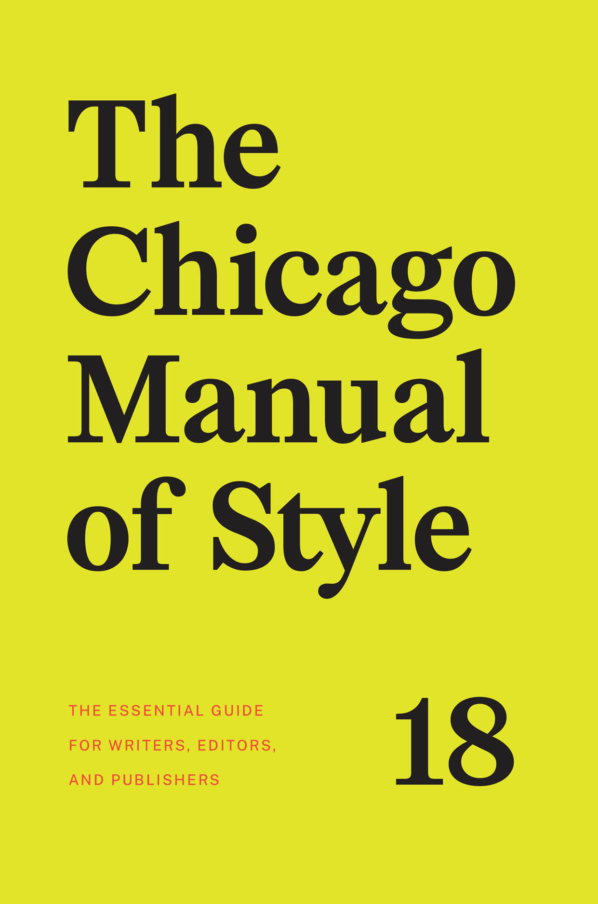
Key characteristics
3
Chicago style refers to a widely used “notes and bibliography” system for citing sources based on guidelines set forth in the Chicago Manual of Style (CMOS), 18th edition.
Chicago style is often a requirement for research essays and course papers written in the humanities and the arts.
Formal citation of sources is a requirement of Chicago Style, when quoting, paraphrasing, and summarizing sources.
Chicago style offers two options for citing sources: Notes and Bibliography format or Author-Date format.
This guidebook focuses on Notes and Bibliography formatting, which entails using footnotes or endnotes.

Slide 4
NOTES AND BIBLIOGRAPHY
(Footnotes)
4
Marie-Louise’s lineage presented her as dynastically potent, a term that encompasses the power of her descent, natal family, and the potential production of her womb.⁴
A footnote is a source citation at the “foot” of a page that corresponds to a raised “superscript” numeral at the end of quoted, paraphrased, or summarized content.
Microsoft Word auto-formats footnotes if you select from the “Insert” tab on a Mac or the “References” tab on a PC.
Include a page number in the footnote if a source is paginated.
Sources, such as scriptural texts, legal statutes, and court decisions, require citations in notes but not bibliographies.
⁴ Lindsay Dunn, “Creating Napoleon’s Dynasty: Marie-Louise, House of Habsburg-Lorraine, and the Art of Statecraft,“ Eighteenth Century Studies 53, no. 2, 257. doi:10.1353/ecs.2020.0008.
CMOS 13.46

Slide 5
NOTES AND BIBLIOGRAPHY
(endnotes)
5
Endnotes
¹ Rebecca Sharpless, Grain and Fire: A History of Baking in the America South (University of North Carolina Press), 18.
² William Meier, “Going to the Hoist: Women, Work, and Shoplifting in London, c. 1890-1940,” Journal of British Studies 50, no. 2 (April 2011): 430.
³ Sharpless, Grain and Fire, 23.
Endnotes are identical to footnotes but listed at the ”end” of a paper but before the bibliography.
Each endnote corresponds to a superscript numeral positioned at the end of quoted, paraphrased, or summarized content.
As you would with a footnote, include a page number in the endnote if a source is paginated.
Once you use a full citation in either footnotes or endnotes, you can adopt a shortened form to cite it thereafter.
CMOS 13.46

Slide 6
FORMATTING PAPERS in CHICAGO Style
6
Visualizing Queenship in the Rose
Window at the Sainte-Chapelle, Paris
John Smith
Art History 10043: Introduction to Art History
September 19, 2022
Create a title page by centering your title and providing relevant information.
Margins should be standard one-inch, flush left, and ragged right. Use a 12-point font, such as Arial or Times New Roman.
Double-space papers, except for block quotes, bibliographies, and captions for illustrations.
Begin numbering pages with a “2” on the first page of text.
At the end of your paper, include a bibliography alphabetized by author surnames, titles, or the first word of an agency’s name (ignore articles, such as “a” and “the”).
CMOS 1.21

Slide 7
Formatting direct quotations
7
Incorporate quotations into your own prose and cite with a superscript and footnote or endnote.
If a quotation is not a full sentence, or is less than 100 words, you can include direct quotes in your writing by incorporating them into your text of your paragraph.
If a quotation is 4 lines or fewer, incorporate it into the text of your paragraph with a “signal phrase.”
Vary the placement of signal phrases to avoid the monotony of always placing them at the beginnings of sentences.
Goethe credits the couple’s mutual devotion to, as Michael Yonan describes, their “humanity, their similarity to the late eighteenth-century German bourgeoisie, and to their sensibility, conceptualized both mutually and toward each other, and between them and their subjects.”¹⁰
CMOS 13.120

Slide 8
Block quotations in CHICAGO STYLE
8
If a quotation is 100 words or more, format it as a block quotation by indenting the entire prose extract 5 spaces or a traditional paragraph tab. Omit quotation marks.
If a quotation is more than one paragraph, format it as a block quotation by indenting the first paragraph flush to the left, but reflect original paragraph breaks for the other paragraphs in the quotation.
Introduce the quote by using a complete sentence in your own words, followed by the block quotation, single-spaced.
To avoid relying on sources too heavily, do not use block quotes excessively or back-to-back.
Imbert de Saint-Armand describes Marie-Louise’s entry into
Strasbourg:
At the bridge over the Rhine, which the Empress reached at five in the evening, she was met by twenty French generals and several divisions under arms. The bridge was decorated with flags; bells were pealing; salvos of artillery were roaring. At the entrance of the bridge the sovereign was welcomed by the Prefect of the Lower Rhine, and at the city gates by the Mayor.²
CMOS 12.31, 12.22-81

Slide 9

poetry quotations IN CHICAGO STYLE
9
If quoting two or more lines of poetry, format a quote as you would in prose and use slash marks ( / ) to indicate line breaks.
Block-quote a poetry extract that exceeds 3 lines, replicating the line breaks of the original source but omitting quotation marks.
In “Foreday in the Morning,” Jericho Brown writes, “My mother grew morning glories that spilled onto the walkway toward her porch/Because she was a woman with land who showed as much by giving it color” (1-2).
Jericho Brown writes,
My mother grew morning glories that spilled onto the walkway toward her porch
Because she was a woman with land who showed as much by giving it color
She told me I could have whatever I worked for. That means she was an American.
But she’d say it was because she believed
In God.
Jericho Brown, “Foreday in the Morning,” 1-2.
CMOS 2.24, 12.33
Notes:
CHANGE BULLETS TO CMOS

Slide 10
The BIBLIOGRAPHY page
10
Bibliography
Aaslestad, Katherine. “Republican Traditions: Patriotism,
Gender, and War in Hamburg, 1770-1815.”
European History Quarterly 37 (2007): 582-602.
Boime, Albert. The Academy and French Painting in the
Nineteenth Century. Yale
University Press, 1986.
Lacan, Jacques. “The Mirror Stage as Formative of the
Function of the “I.” In Ecrits: A Selection. Edited and
translated by Alan Sheridan. Tavistock, 1977.
Sheriff, Mary D. “The Cradle is Empty: Elisabeth Vigée-
Lebrun, Marie-Antoinette, and the Problem of
Intention.” In Women, Art, and the Politics of Identity
in Eighteenth-Century Europe. Edited by Melissa
Hyde and Jennifer Milam. Ashgate Press,
2004, 164-187.
A bibliography is a complete list of sources used in the paper, each source formally cited in Chicago style. Bibliography is placed at the end of the paper.
Alphabetize the list by author surnames, titles, or the first word of an agency’s name (ignore articles, such as “a” and “the”).
If the source has no author listed, use the title to determine where to place it in alphabetical order. Begin each entry flush with the left margin, but indent subsequent lines 5 spaces for a “hanging indent.”
Chicago recommends the word-by-word system but will accept the letter-by-letter system. Under the word-by-word system, an entry for “Fernán Gómez, Fernando” would precede an entry for “Fernández, Angelines”; under the letter-by-letter system, the opposite order would prevail.
CMOS 1.70, 13.18-68

Slide 11
Annotated Bibliographies
11
An annotated bibliography is a special type that includes a short synopsis of the source’s content in addition to the standard reference entry information.
Alphabetize annotated bibliographies by author surname, along with a “hanging indent.” The annotation is also indented.
Avoid repeating any information already conveyed in the bibliographic entry.
Sheriff, Mary D. The Exceptional Woman: Elisabeth Vigée-Lebrun and the
Cultural Politics of Art. University of Chicago Press, 1996.
Sheriff investigates the ways in which eighteenth-century society
classified women artists as exceptional and explores the
mechanisms in place that stunted women’s artistic growth,
ensuring that only a few could succeed. She uses the career of
Vigée-Lebrun as a case study to understand how a woman artist
acting in the public sphere negotiated gender norms, social
institutions, and politics when creating portraits for the
aristocratic elite.
CMOS 13.68, figure 13.10

Slide 12
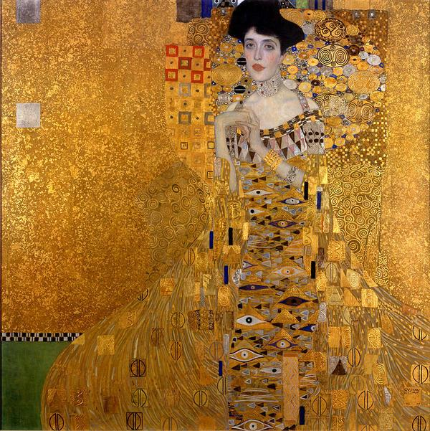
Formatting Illustrations and figures in
CHICAGO STYLE
12
Figures (images) should be incorporated into your paper in proximity to the first mention, unless an assignment requires them to appear at the end.
Refer to a figure only by its numbered title.
Number all figures sequentially in boldface Arabic numerals, accompanied by a brief, accurate title below the figure.
Include complete source information on figures in the bibliography.
Illustrations used for more than decorative purposes will need an alt text, similar to a traditional caption but describes what the image shows rather than merely what it is. If some of these details are included in the text near the image, the alt text can be shorter.
Figure 3. Gustav Klimt. Portrait of Adele Bloch-Bauer, 1907; Neue Galerie.
CMOS 2.31-35

Slide 13
Sample FIGURE, CAPTION,
AND ALT TEXT
13
Caption
  Gustav Klimt’s Portrait of Adele Bloch-Bauer I, 1907. Neue Galerie New York.
Alt Text
  Painting of Adele Bloch-Bauer standing and immersed in gold leaf, a style popularized by Austrian artist Gustav Klimt, created by Klimt sometime between 1903 to 1907. Her dress is decorated with a pattern resembling eyes, and round shapes and spirals surround her upper body, primarily shoulders and head. The only substantial space that is not golden is a patch of green in the bottom left corner. There are also small hints of whites, reds, pinks, blues, greys, and browns throughout the composition.
Figure 3. Gustav Klimt. Portrait of Adele Bloch-Bauer, 1907; Neue Galerie.
CMOS 2.31-35

Slide 14
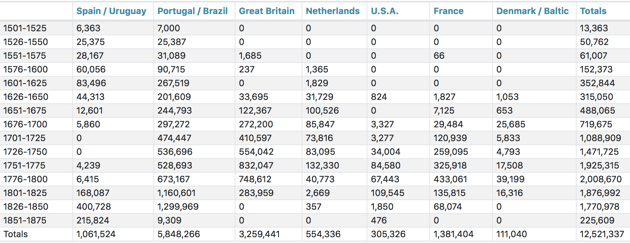
Formatting tables in CHICAGO Style
13
Incorporate tables into the body of a Chicago style paper, in close proximity to the first mention.
All tables must be numbered sequentially in boldface Arabic numerals, accompanied by a brief, accurate title.
In the paper, refer to a table only by its assigned number and title.
If you are reproducing or adapting figures or tables from another source, you must acknowledge the copyright of the source in a note below the figure and in your bibliography.
TABLE 4. Transatlantic Slave Trade by Country
Figure 7. A nine-column table depicting slave trade increase in 7 countries, with totals. Adapted from: Trans-Atlantic Stave Trade Estimates, Slave Voyages, July 2020,
https://www.slavevoyages.org/assessment/estimates.
CMOS 2.31-36

Slide 15
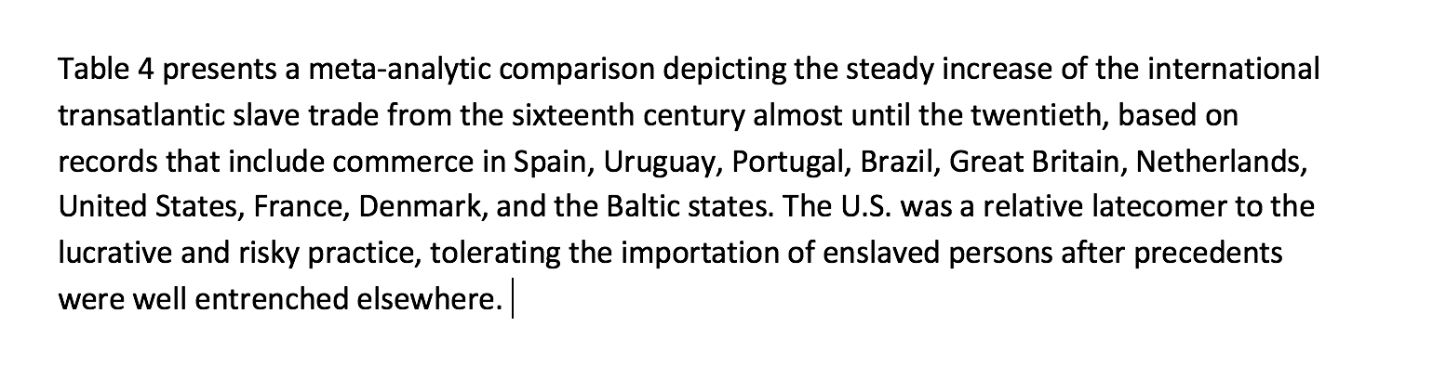
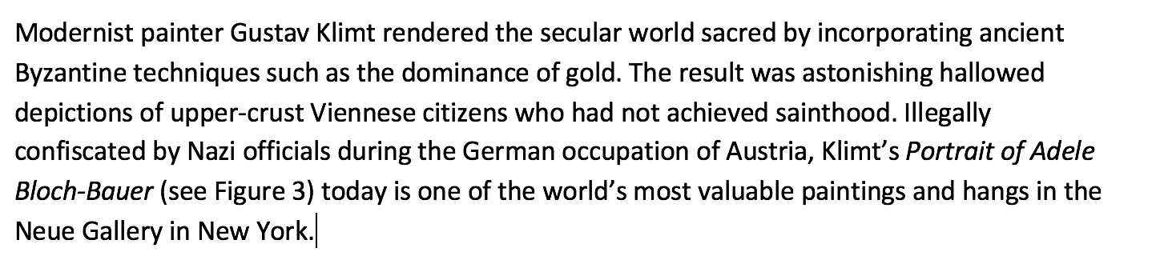
TEXT ANCHORS, Callouts, AND TEXT REFERENCES
14
Avoid using directional words, such as “above” or “below,” to refer to figures or tables in your paper.
Refer to figures and tables only by their numbers and titles: Figure 3, Table 6. This mention is a “text anchor,” ”callout,” or a “text reference.”
Every figure or table included must have a text anchor or reference in the paper; every callout must correspond to a figure.
CMOS 3.51

Slide 16

Common EXAMPLES OF
CHICAGO NOTES AND BIBLIOGRAPHY
15
CMOS 14.10-304

Slide 17

Book with one author (Print)
16
Note:
¹ Rebecca Sharpless, Grain and Fire: A History of Baking in the American South, (University of North Carolina Press, 2022), 18.
Short Form:
² Sharpless, Grain and Fire, 23.
Bibliography:
Sharpless, Rebecca. Grain and Fire: A History of Baking in the American
South. University of North Carolina Press, 2022.
CMOS 13.22
Notes:
checked

Slide 18
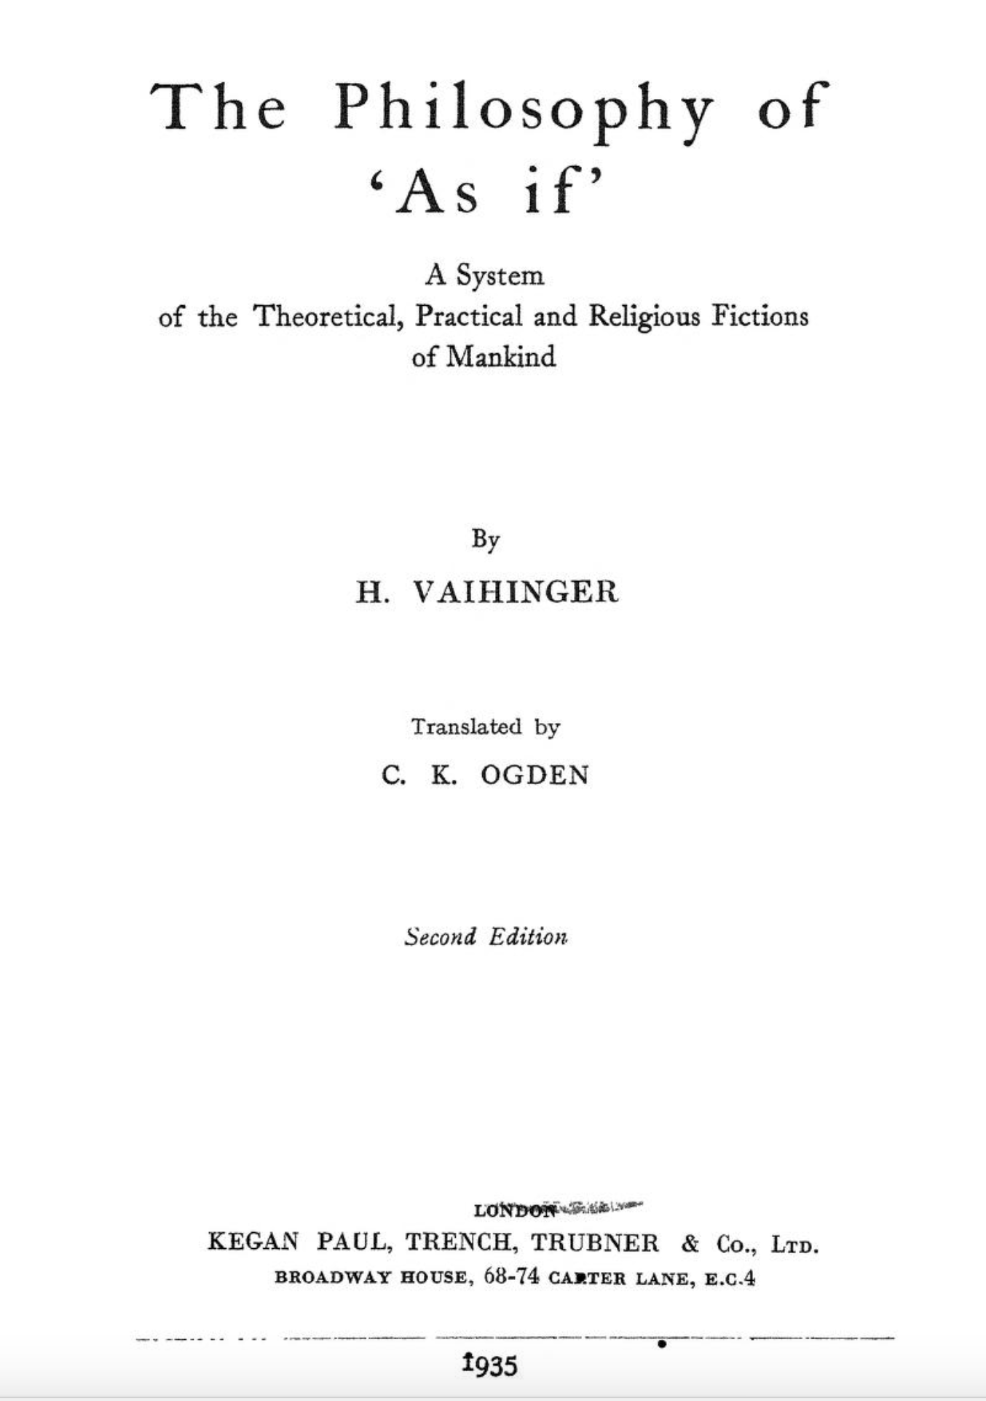
Books consulted online
17
Note:
⁹ Hans Vaihinger, The Philosophy of “As If,” translated by
C.K. Odgen, (Kegan Paul, Trench,& Trubner, 1935),16,
https://archive.org/details/in.ernet.dli.2015.188061.
Short Form:
¹⁰ Vahinger, The Philosophy of “As If,” 17.
Bibliography:
Vaihinger, Hans. The Philosophy of “As If,” translated by C.K. Odgen. Kegan Paul, Trench,& Trubner, 1935.
https://archive.org/details/in.ernet.dli.2015.188061.
CMOS 14.161

Slide 19
CONTRIBUTION TO A MULTI-AUTHORED BOOK OF ESSAYS
18
Note:
⁵ Mary D. Sheriff, “The Cradle is Empty: Elisabeth Vigée-Lebrun, Marie-Antoinette and the Problem of Intention,” in Women and the Politics of Identity in Eighteenth-Century Europe, ed. Jennifer Milam and Melissa Hyde (Ashgate Press 2004), 168.
Short Form:
⁶ Sheriff, “The Cradle is Empty,” 168.
Bibliography:
Sheriff, Mary D. “The Cradle is Empty: Elisabeth Vigée-Lebrun, Marie-
Antoinette and the Problem of Intention.” In Women and the Politics
of Identity in Eighteenth-Century Europe, edited by Jennifer Milam
and Melissa Hyde. Ashgate Press, 2004, 164-187.
CMOS 14.9
Notes:
checked

Slide 20
organization or agency as author
19
Note:
²³ BLM (Bureau of Land Management), Private Maintenance and Care Agreement for Wild Horse(s) and Burro(s), Form 4710-9: June 2021, https://www.blm.gov/sites/default/files/docs/2021-06/4710-009.pdf.
Short form:
²⁴ BLM, Private Maintenance and Care, 2.
Bibliography:
BLM (Bureau of Land Management). Private Maintenance and Care Agreement
for Wild Horse(s) and Burro(s). Form 4710-9: June 2021.
https://www.blm.gov/sites/default/files/docs/2021-06/4710-009.pdf.
CMOS 14.117
Notes:
checked

Slide 21
Peer-reviewed journal in PRINT
20
Note:
¹ William Meier, “Going on the Hoist: Women, Work, and Shoplifting in London, c. 1890-1940,” Journal of British Studies 50, no. 2 (April 2011): 416.
Short form:
² Meier, “Going on the Hoist,” 430.
Bibliography:
Meier, William. “Going on the Hoist: Women, Work, and Shoplifting in London,
c. 1890-1940.” Journal of British Studies 50, no. 2 (April 2011): 410-433.
CMOS 1.87, 13.26
Notes:
checked

Slide 22
Peer-reviewed journal
Online
21
Note:
⁹ Todd Kerstetter, “Spin Doctors at Santee: Missionaries and the Dakota-Language Reporting of the Ghost Dance and Wounded Knee,” Western Historical Quarterly 28, no. 1(Spring 1997): 45, https://doi.org/10.2307/971202.
Short form:
¹⁰ Kerstetter, “Spin Doctors,” 50.
Bibliography:
Kerstetter, Todd. “Spin Doctors at Santee: Missionaries and the Dakota-Language
Reporting of the Ghost Dance and Wounded Knee.” Western Historical
Quarterly 28, no. 1(Spring 1997): 45-67. https://doi.org/10.2307/971202.
CMOS 13.26
Notes:
checked

Slide 23
magazine article Online
22
Note:
²² Kia D. Goosby and Miles Pope, “What It’s Really Like to Be a Fashion Editor During New York Fashion Week,” Vanity Fair, September 12, 2022, https://www.vanityfair.com/style/2022/09/what-its-really-like-to-be-a-fashion-editor-during-new-york-fashion-week.
Short Form:
²³ Goosby and Pope, “What It’s Really Like.”
Bibliography:
Goosby, Kia D., and Miles Pope. “What It’s Really Like to Be a Fashion Editor During New York Fashion Week.” Vanity
Fair, September 12, 2022. https://www.vanityfair.com/style/2022/09/what-its-really-like-to-be-a-fashion-editor-
during-new-york-fashion-week.
CMOS 14.65, 14.87

Slide 24
newspaper article Online
23
Note:
⁶ Charles Blow, “America’s ‘Psychic Numbing’ to Gun Violence,” The New York Times,
September 6, 2022, https://www.nytimes.com/2022/06/08/opinion/numbing-gun-violence.html.
Short Form:
⁷ Blow, “America’s ‘Psychic Numbing.’”
Bibliography:
Blow, Charles. “America’s ‘Psychic Numbing’ to Gun Violence.” The New York Times, September 6,
2022. https://www.nytimes.com/2022/06/08/opinion/numbing-gun-violence.html.
CMOS 14.89

Slide 25
dictionary or encyclopedia online
24
Note:
⁴ Britannica Concise Encyclopedia, “Franz Boas,” by Encyclopedia Britannica. Britannica Digital Learning, 2017. Accessed May 5, 2021, https://search.credoreference.com/content/entry/ebconcise/boas_franz/0.
Short Form:
⁵ Britannica Concise Encyclopedia, “Franz Boas.”
Bibliography:
Not cited in bibliographies
CMOS 14.131
Notes:
Checked.

Slide 26
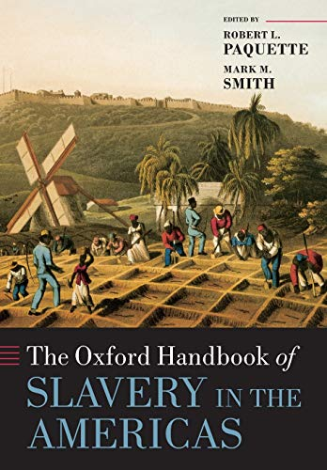
dictionary or encyclopedia with authors
25
Note:
³ Alan Gallay, “Indian Slavery,” in The Oxford Handbook of Slavery in the Americas, ed.
Mark M. Smith and Robert Paquette, (Oxford University Press, 2010).
Short Form:
⁴ Gallay, “Indian Slavery.”
Bibliography:
Gallay, Alan. "Indian Slavery," in The Oxford Handbook of Slavery in the Americas,
edited by Mark M. Smith and Robert Paquette. Oxford University Press,
2010, 312-335.
CMOS 14.132
Notes:
checked

Slide 27
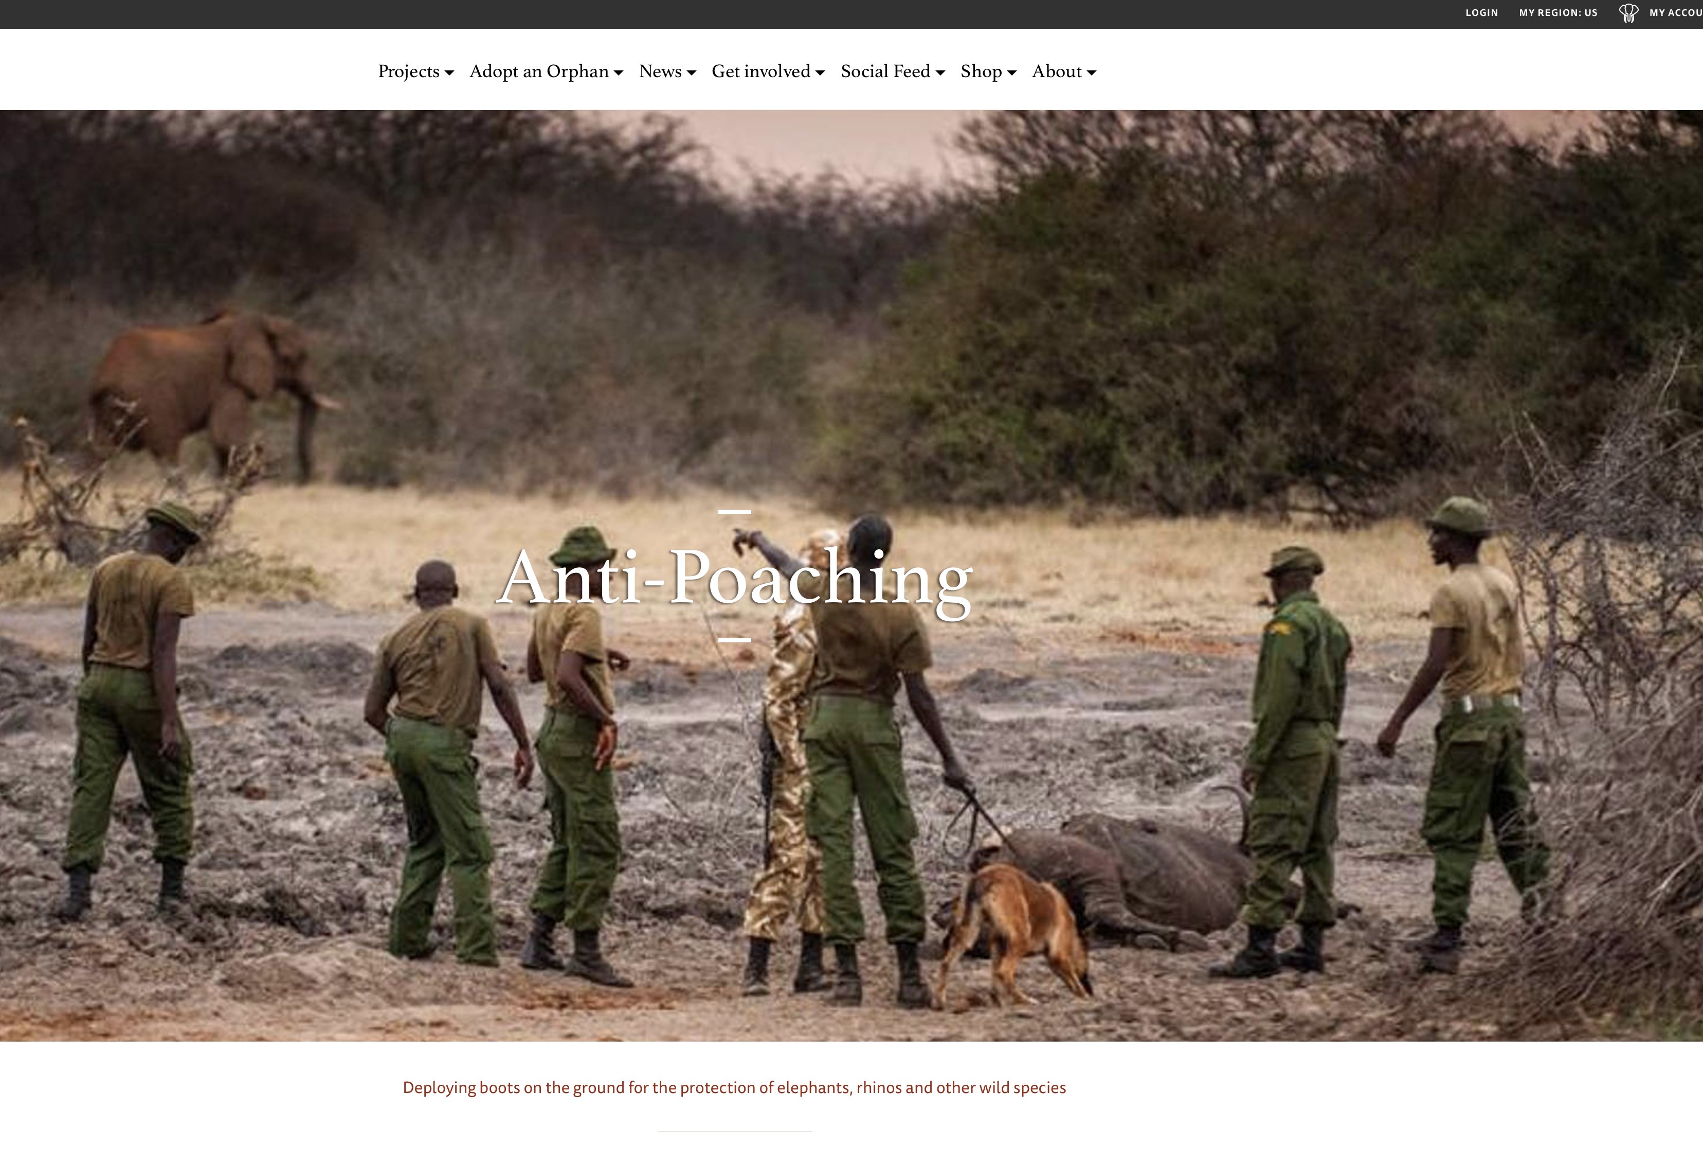
Website
26
Note:
Note:
¹¹ Sheldrick Wildlife Trust, “Anti-Poaching,” Sheldrick Wildlife Trust, accessed Oct. 11, 2022, https://www.sheldrickwildlifetrust.org/projects/anti-poaching.
Short Form:
¹² Sheldrick Wildlife Trust, “Anti-Poaching.”
Bibliography:
Sheldrick Wildlife Trust. “Anti-Poaching.” Sheldrick Wildlife Trust. Accessed
October 11, 2022. https://www.sheldrickwildlifetrust.org/projects/anti-
poaching.
CMOS 14.104

Slide 28
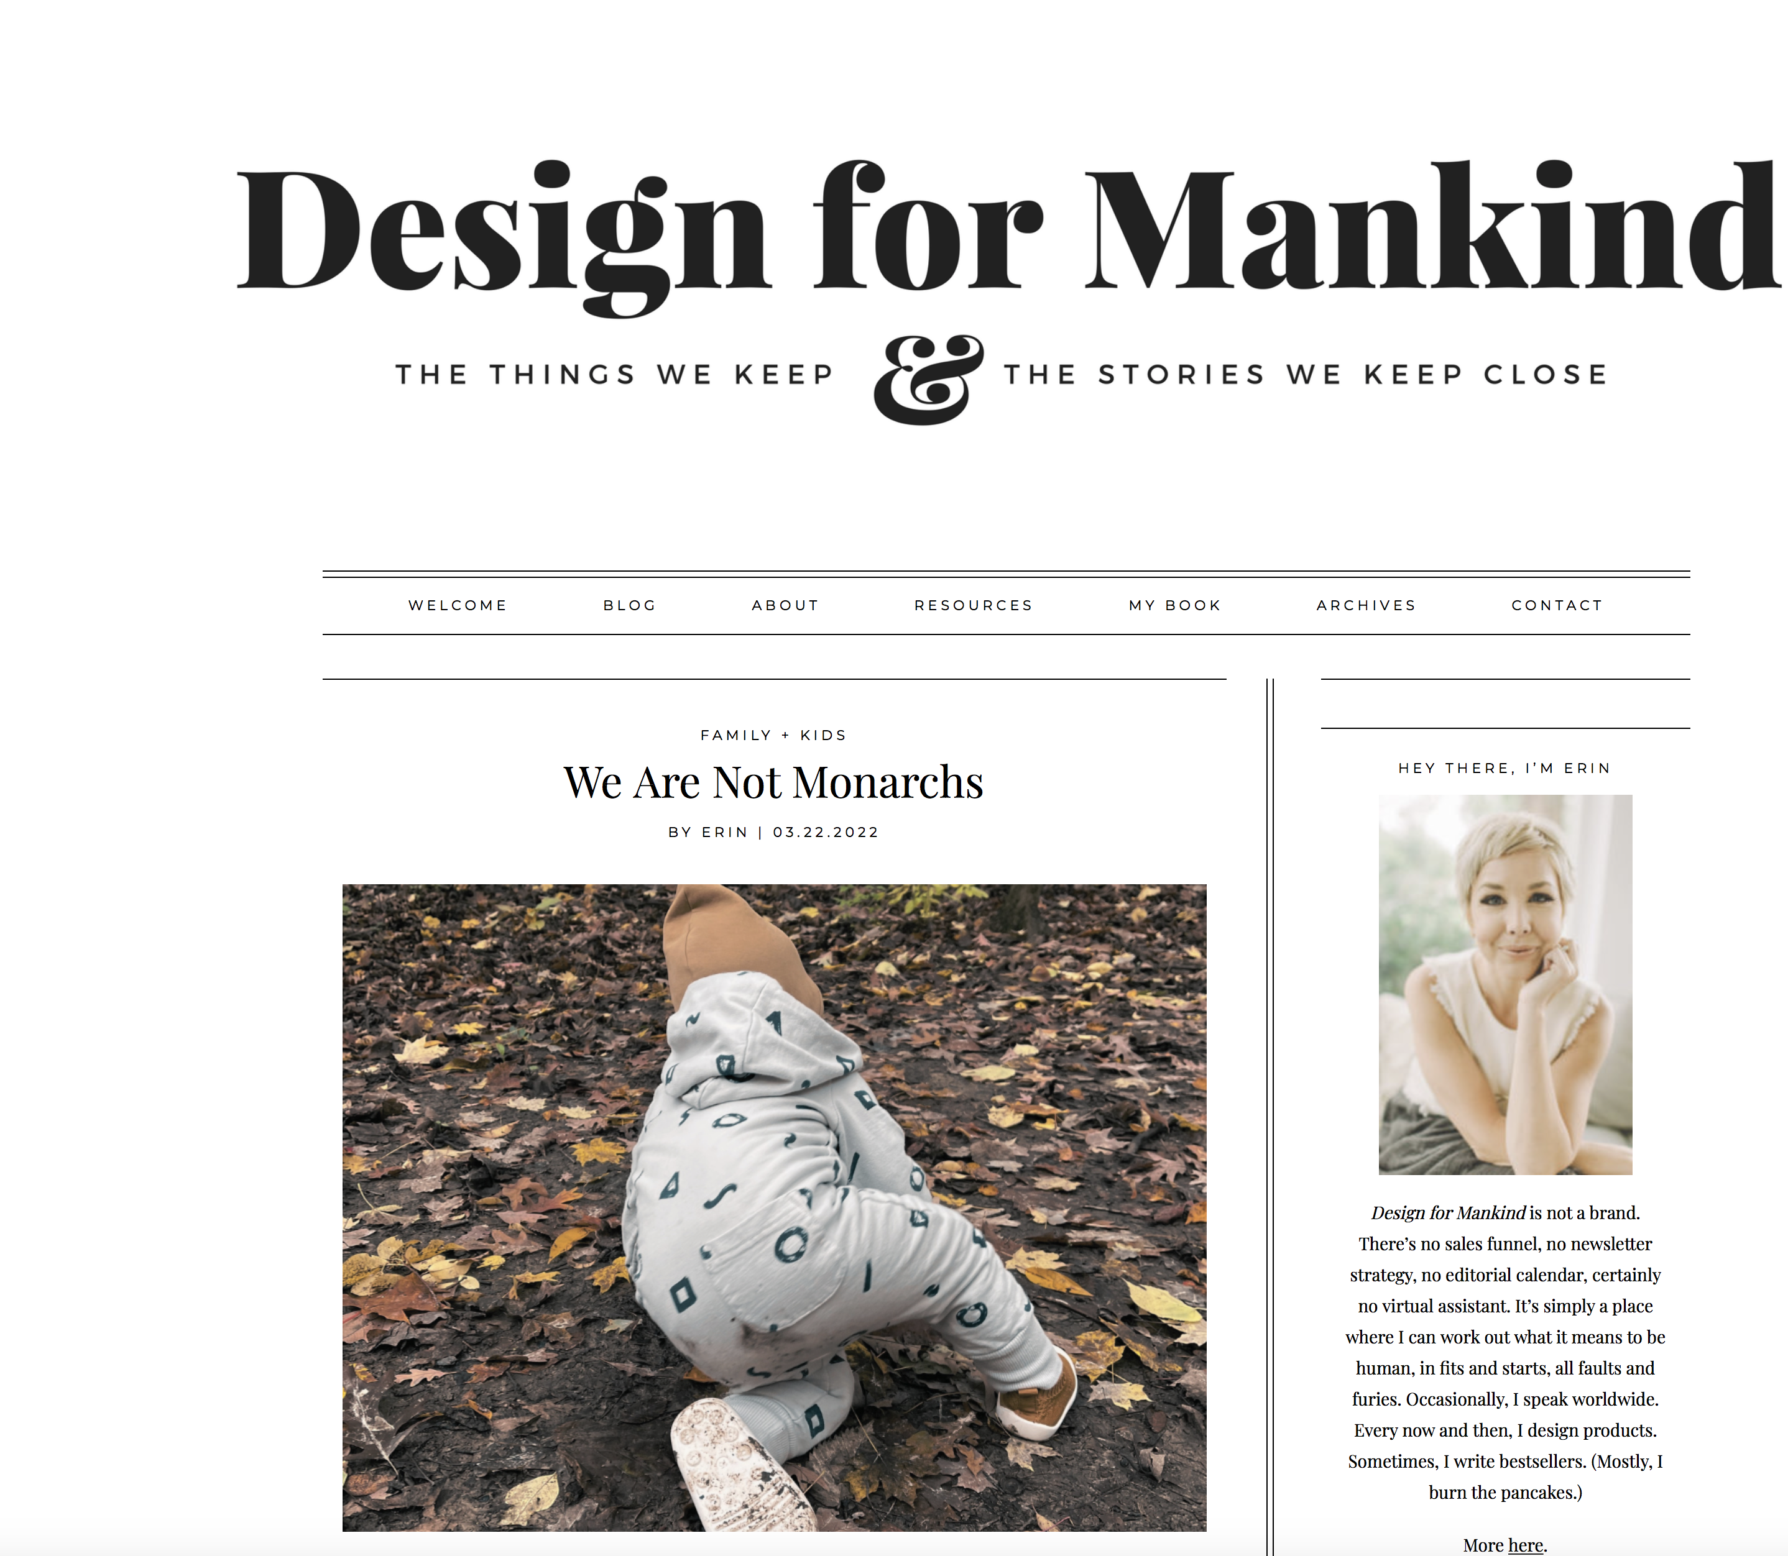
blog post
27
Note:
²³ Erin Loechner, “We Are Not Monarchs,” Design for Mankind (blog),
March 22, 2022, https://designformankind.com/blog/.
Short Form:
²⁴ Loechner, “We Are Not Monarchs.”
Bibliography:
Loechner, Erin. “We Are Not Monarchs.” Design for Mankind (blog). March 22, 2022.
https://designformankind.com/blog/.
CMOS 14.105
Notes:
checked

Slide 29

Podcast
28
Note:
¹³ Riley Ford, Kara Dixon Vuic, host, The History Frogcast, podcast, season 3, teaser “Season 3 Teaser,” Texas Christian University Department of History, December 12, 2024, https://frogcast.tcu.edu/season-3-teaser/.
Short Form:
¹⁴ Ford and Vuic, “Season 3 Teaser.”
Bibliography:
Ford, Riley and Kara Dixon Vuic. The History Frogcast, podcast, “Season 3 Teaser.” December 12, 2024, MP3 audio, 3:51. https://frogcast.tcu.edu/season-3-teaser/.
CMOS 14.168
Notes:
Checked.

Slide 30
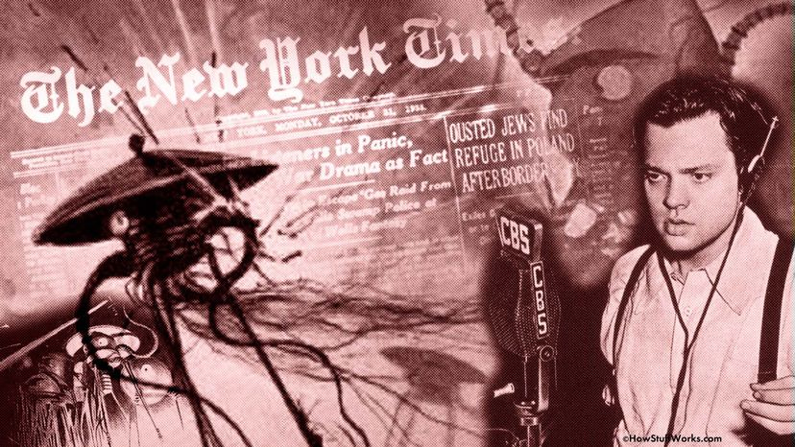
Archival Radio broadcast
29
Note:
⁴ Orson Welles, The War of the Worlds, Columbia Broadcasting System
(CBS), October 30, 1938, :45. https://www.youtube.com/watch?v=9q7tN7MhQ4I.
Short Form:
⁵ Welles, The War of the Worlds, 2:34.
Bibliography:
Welles, Orson. The War of the Worlds. Columbia Broadcasting System
(CBS), October 30, 1938, :45. YouTube. https://www.youtube.com/watch?v=9q7tN7MhQ4I.
CMOS 14.164

Slide 31

Supreme court ruling
30
Note:
⁹ Brown v. Board of Education, 347 U.S. at 483 (1954), https://www.oyez.org/cases/1940-1955/347us483.
Short Form:
¹⁰ Brown v. Board of Education.
Bibliography:
Not usually included in bibliography
CMOS14.178
Notes:
checked

Slide 32
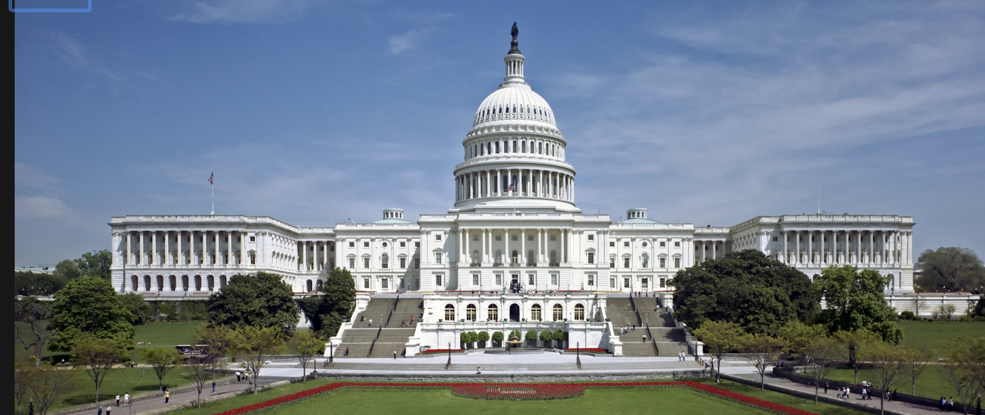
FEDERAL STATUTE
31
Note:
⁸Lilly Ledbetter Fair Pay Act of 2009, Pub L. No. 111-2, 123 Stat. 5 (2009).
Short Form:
⁹Lilly Ledbetter Fair Pay Act of 2009.
Bibliography:
Not usually included in bibliography
CMOS 14.183
Notes:
Checked.

Slide 33

Song on a streaming platform
32
Note:
¹⁶ Vince Gill, “Look at Us,” Spotify, track 2 on Pocket Full of Gold, MCA Records, 1991.
Short Form:
¹⁷ Gill, “Look At Us.”
Bibliography:
Gill, Vince. “Look at Us.” Spotify. Track 2 on Pocket Full of Gold. MCA Records, 1991.
CMOS 14.163
Notes:
Checked

Slide 34

Youtube or streaming video
33
Note:
³ Bill Gates, “The Best Teacher I Never Had,” YouTube, January 27, 2016, https://www.youtube.com/watch?v=WOoJh6oYAXE.
Short Form:
⁴ Bill Gates, “The Best Teacher I Never Had.”
Bibliography:
Gates, Bill. “The Best Teacher I Never Had.” YouTube, January 27, 2016.
https://www.youtube.com/watch?v=WOoJh6oYAXE.
CMOS 14.167

Slide 35
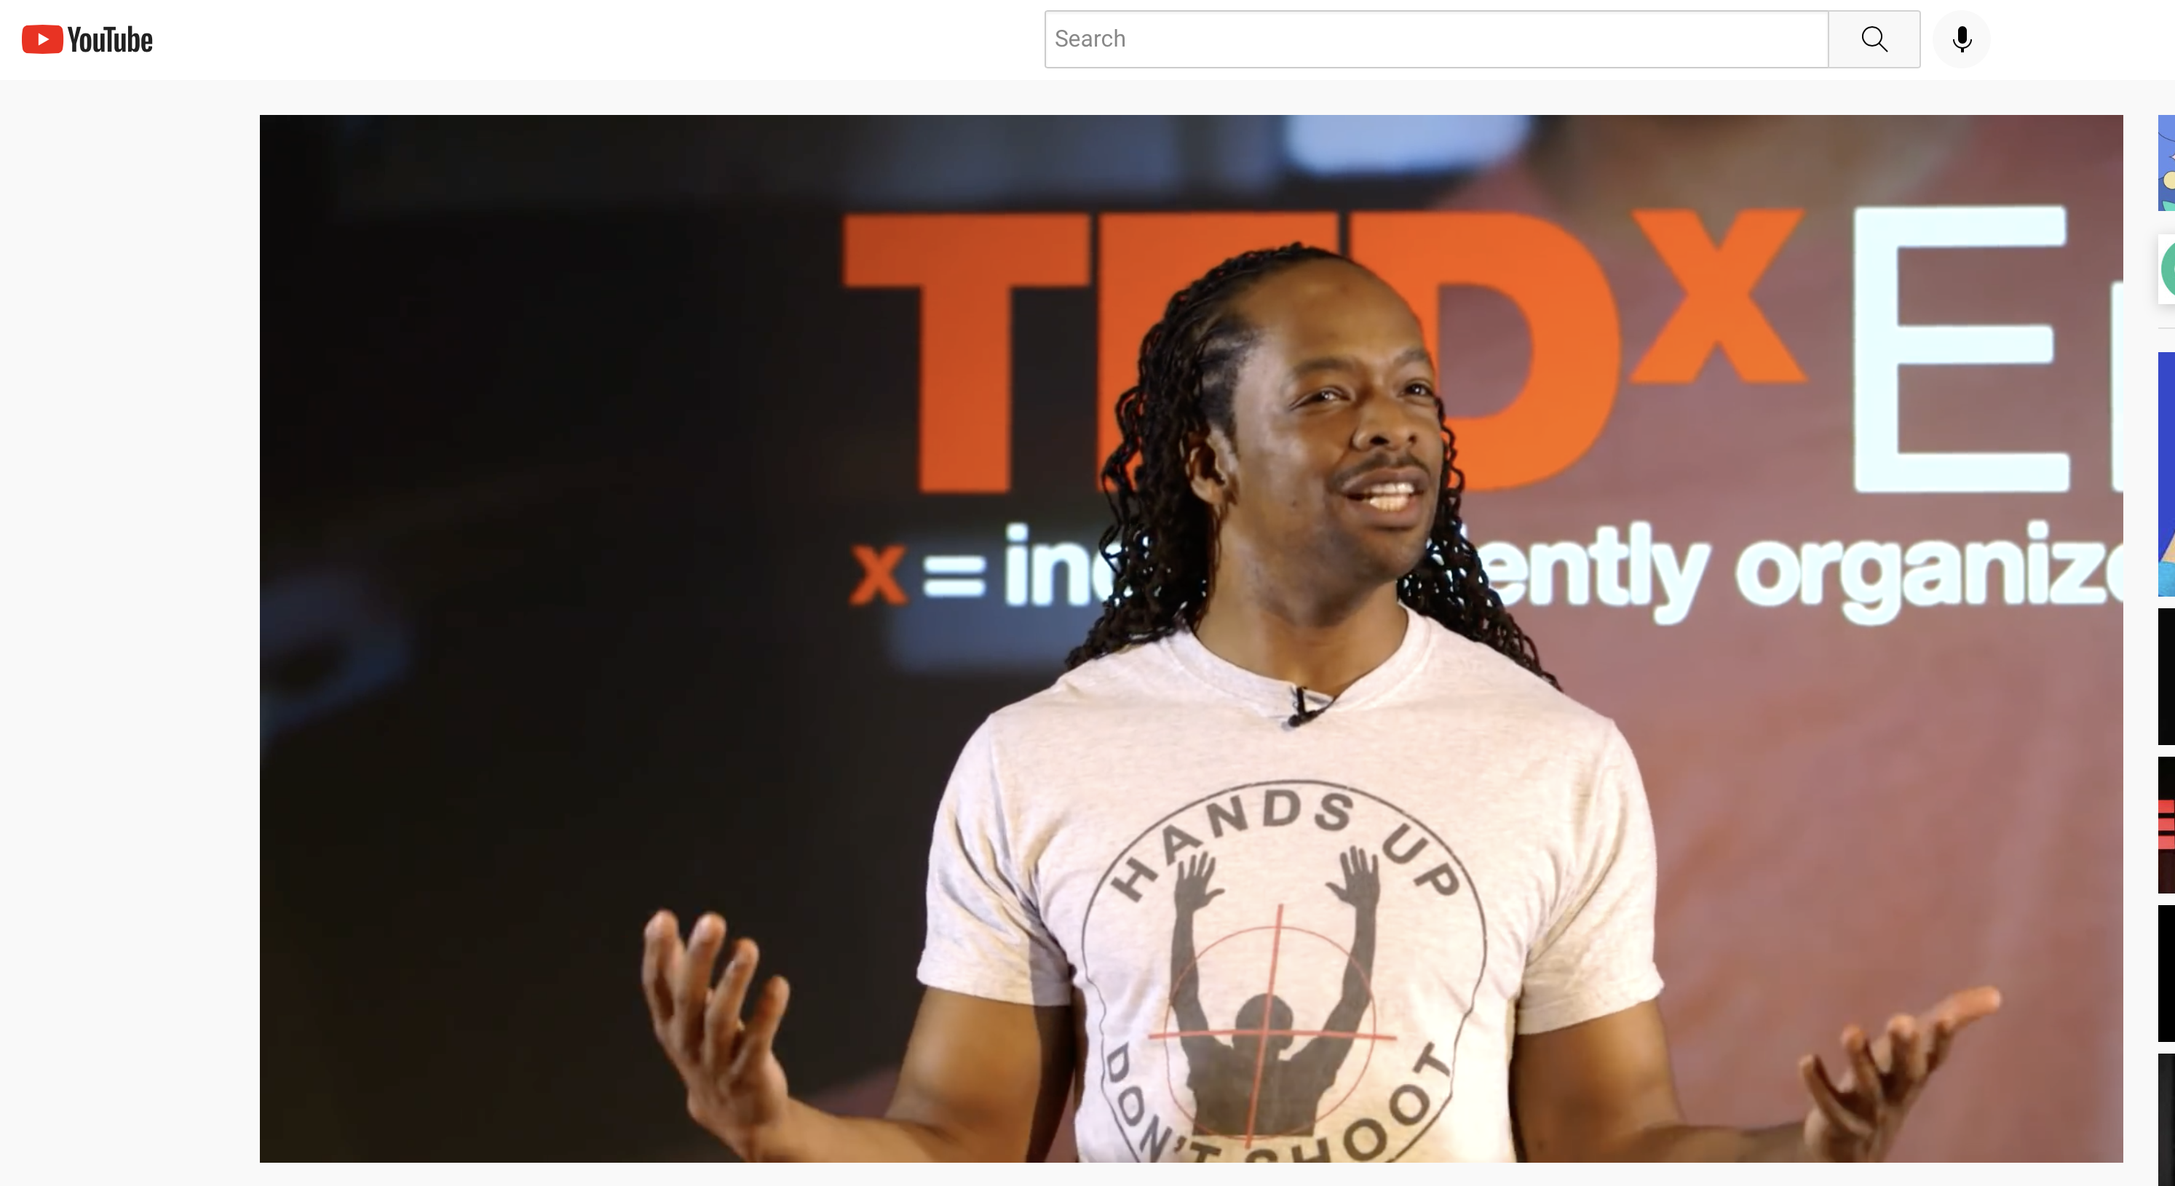
Ted talk / webinar
34
Note:
¹ Jericho Brown, “The Art of Words,” filmed May 27, 2015, at Emory University, TEDxEmory video 16:09, https://www.youtube.com/watch?v=0DsG-tMZjKY.
Short Form:
² Brown, “The Art of Words.”
Bibliography:
Brown, Jericho. “The Art of Words.” Filmed May 27, 2015, at Emory University.
TEDxEmory video 16:09. https://www.youtube.com/watch?v=0DsG-tMZjKY.
CMOS 14.167
Notes:
checked

Slide 36
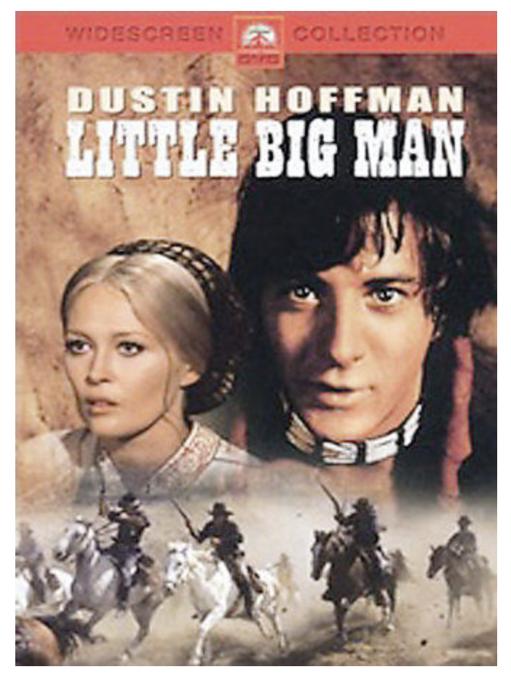
Film screening or dvd
35
Note:
⁶ Little Big Man, Directed by Arthur Penn. (National General Pictures, 1970).
Short Form:
⁷ Penn, Little Big Man.
Bibliography:
Penn, Arthur, dir. Little Big Man. National General Pictures, 1970.
CMOS 14.165
Notes:
checked

Slide 37
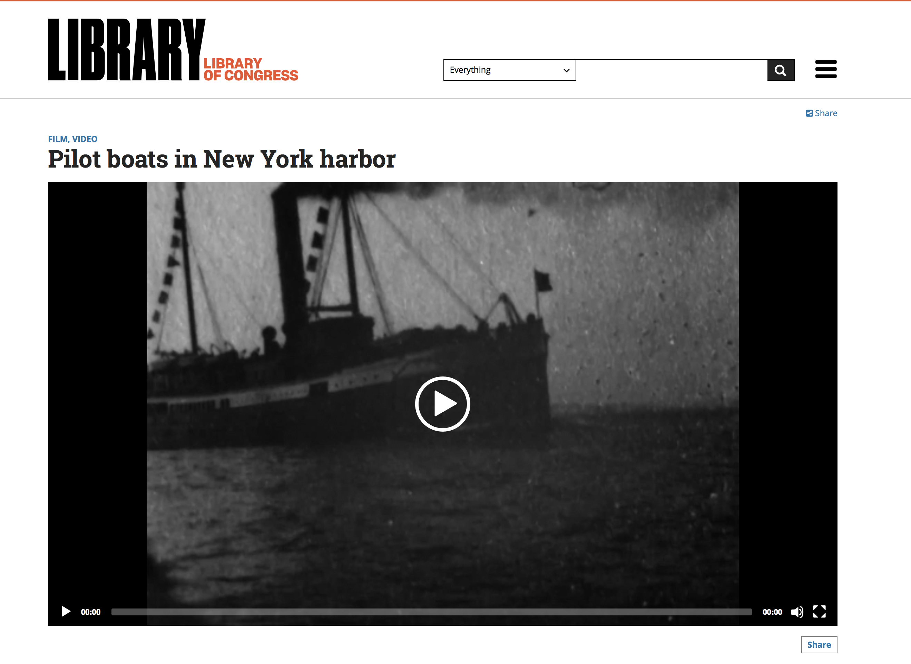
ARCHIVAL FILM ONLINE
36
Note:
¹⁰ Thomas A. Edison, Pilot Boats in New York Harbor (Thomas A. Edison, Inc., 1899), 35mm film, from Library of Congress, The Life of a City: Early Films of New York, 1898-1906. MPEG video, 0:48 at 15fps, https://www.loc.gov/item/00694407/.
Short Form:
¹¹ Edison, Pilot Boats in New York Harbor.
Bibliography:
Edison, Thomas A. Pilot Boats in New York Harbor. Thomas A. Edison, Inc., 1899.
35mm film. Library of Congress, The Life of a City: Early Films of New York,
1898—1906. MPEG video, 0:48 at 15fps. https://www.loc.gov/item/00694407/.
CMOS 14.165
Notes:
checked

Slide 38
Visual art viewed online
37
Note:
⁹ Gustav Klimt, Portrait of Adele Bloch-Bauer, 1907, Oil on canvas, 140 cm x 140 cm, Neue Galerie, New York,
Object no. 2006.04, https://www.neuegalerie.org/content/adele-bloch-bauer-i.
Short Form:
¹⁰ Klimt, Portrait of Adele Bloch-Bauer.
Bibliography:
Klimt, Gustav. Portrait of Adele Bloch-Bauer. 1907. 140 cm x 140 cm. Neue Galerie, New York, object no 2006.04.
New York. https://www.neuegalerie.org/content/adele-bloch-bauer-i.
CMOS 14.133
Notes:
checked

Slide 39
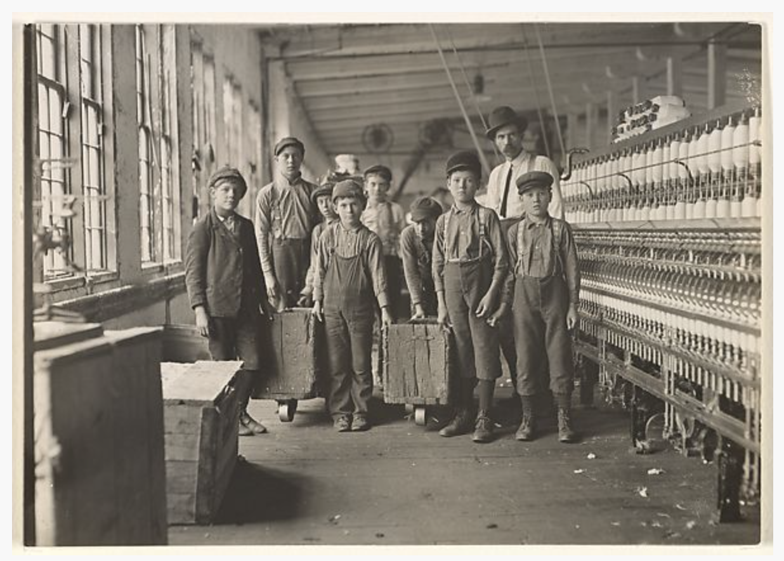
Archival Photograph
38
Note:
¹ Lewis Hine, Mill Children #440, South Carolina, 1908, gelatin silver print, 11.9 x 16.9 cm (4 11/16 x 6 5/8 in.), Metropolitan Museum of Art, New York, object no. 2011.553.8, https://www.metmuseum.org/art/collection/search/301920.
Short Form:
² Hine, Mill Children #440.
Bibliography:
Hine, Lewis. Mill Children #440, South Carolina. 1908. Gelatin silver print, 11.9 x
16.9 cm (4 11/16 x 6 5/8 in.). Metropolitan Museum of Art, New York, object no. 2011.553.8.
https://www.metmuseum.org/art/collection/search/301920.
CMOS 14.133
Notes:
Checked

Slide 40
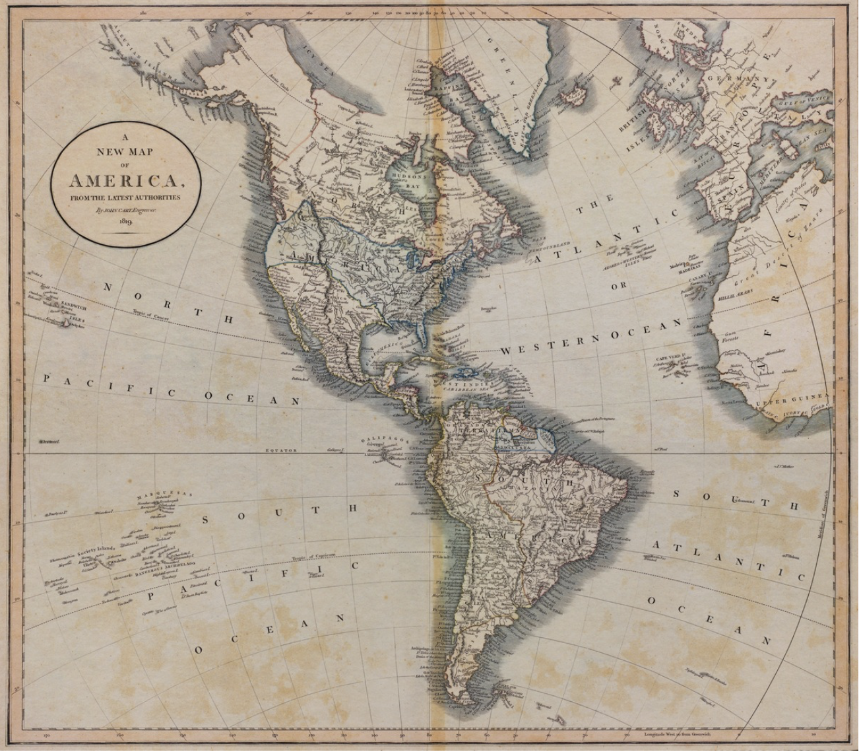
HISTORICAL MAP
39
Note:
¹ John Cary, cartographer, A New Map of America From the Latest Authorities, 1819, 44.6 x 51 cm, George T. Abell Map Collection, Texas Christian University, https://repository.tcu.edu/handle/116099117/11579.
Short Form:
² Cary, A New Map of America.
Bibliography:
Cary, John. A New Map of America From the Latest Authorities. 1819. 44.6 x 51 cm.
George T. Abell Map Collection, Mary Couts Burnett Library, Texas Christian University.
https://repository.tcu.edu/handle/116099117/11579.
CMOS 14.135
Notes:
checked

Slide 41
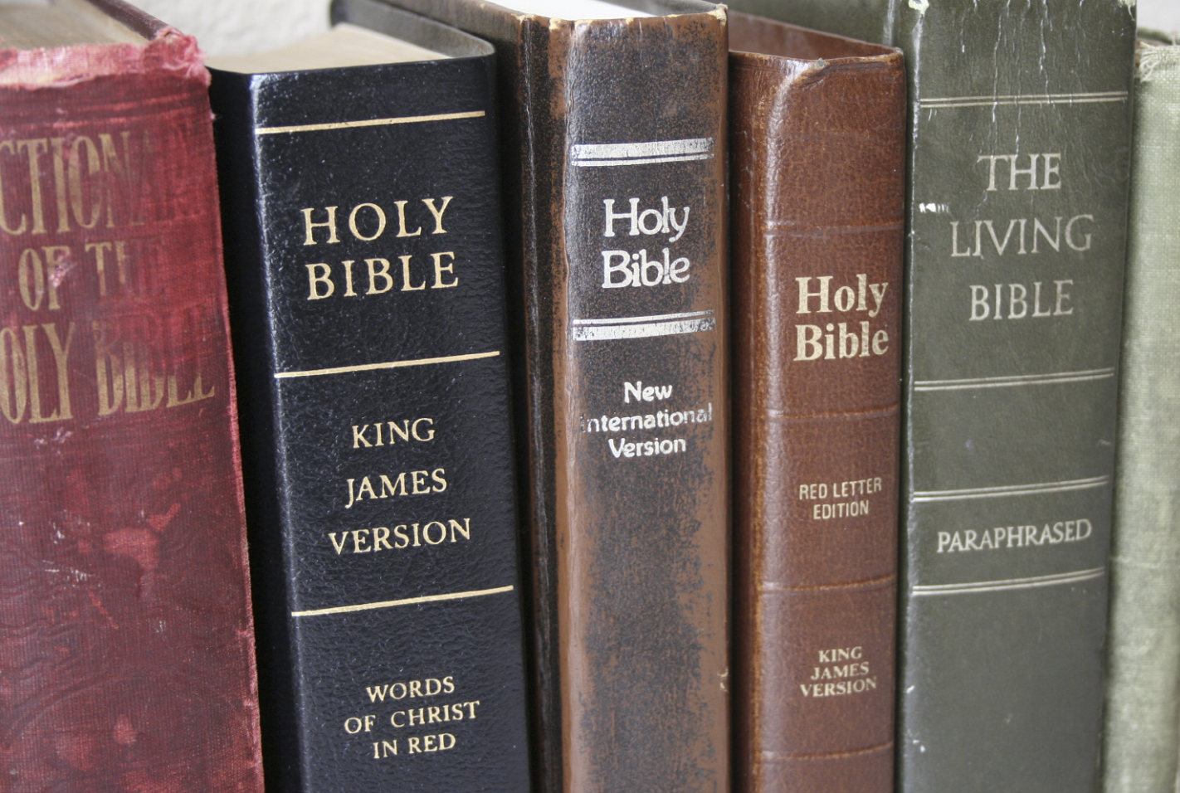
SCRIPTURAL TEXTS
40
Note:
⁷ Proverbs 1:1 (King James Version).
Short Form:
⁸ Proverbs 1:1.
Bibliography:
Not usually included in bibliography
CMOS 14.140
Notes:
checked

