Slide 1


Apa style guide
©️ 2024 W.L. Adams Center for Writing/Texas Christian University

Slide 2
index
2
Narrative Citations……………………………………………….7
Newspaper Article………………………………….………….29
“No date” Citation………………………………………………..8
Online Magazine Article……………………………….......25
Parenthetical Citations…………………………………..…….6
Podcast Episode………………………………………………..35
PowerPoint from a Class Website……………………..38
PubMed Numbers…………………………………………….20
Quotations………………………………………………………….9
Radio Broadcast………………………………………………..37
Reference List …………………………………………………..12
Song or Track on an Album………………………………34
Supreme Court Decision……………………………….….40
Tables………………………………………………………………..15
TED talks and webinars……………………………………..36
Title Page…………………………………………………………….5
Websites…………………………………………………………2, 28
Website with Retrieval Date……………….………….…..28
YouTube or Streaming Video ……………………......33
APA Characteristics……………………………………………….3,4
Agency or Group Authored Report………………….…..31
Annotations………………………………………………………….13
Block Quotations…………………………………..……………..10
Blog Post……………………………………………………….……..26
Book With One Author………………………………..……….21
Book With More Than One Author………………………23
Callouts………………………………………………………………..16
Chapter in Edited Book………………………………………..24
Dictionary or Reference Book Online…………..………30
E-book From a Database……….………………………..…..22
Exceptions in Citations……………………………..……………8
Federal Statute………………………………………………….....39
Figures………………………………………………………………….14
Film or Video………………………………………………………...32
Headings, Levels of………………………………………………..11
In-text Citations……………………………………………………...6
Journal Article with DOI……………………………………......18
Journal Article with URL………………………………..………19

Slide 3
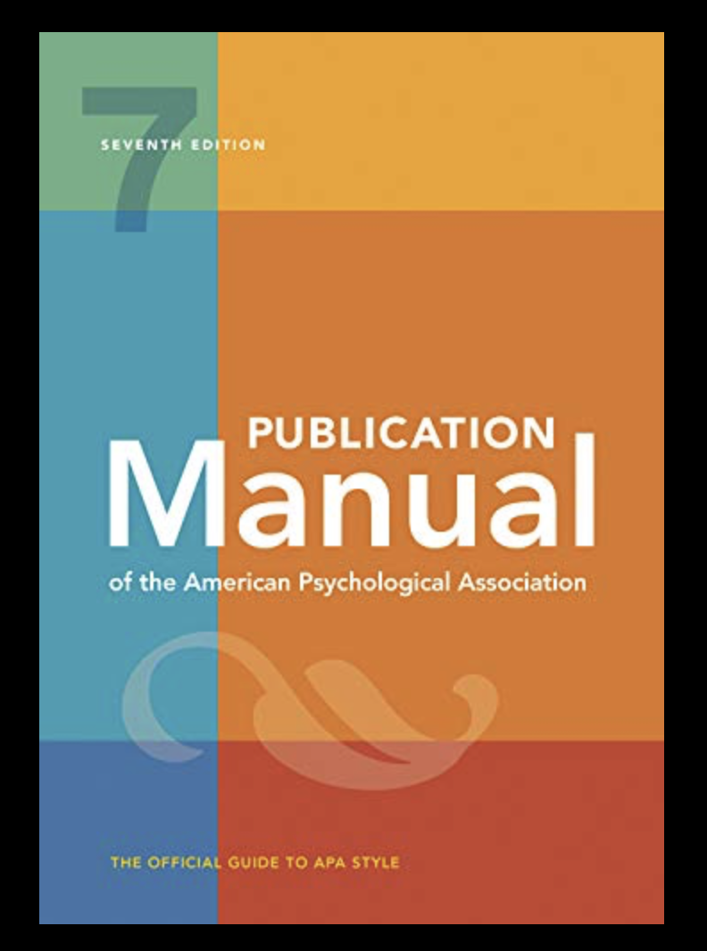
What is APA style?
3
APA Style refers to a system of documentation used by the American Psychological Association.
APA Style is often a requirement of research essays and course papers written in the sciences, medical fields, and business.
APA Style emphasizes the names of researchers and how current the research is by including authors and years in parenthetical citations: (Hart, 2016).

Slide 4
Key characteristics
4
A separate title page
A 12-point, serif font such as Times New Roman or sans serif such as Arial
Parenthetical citations that emphasize author and timeliness: (Smith, 2020)
Page numbers cited only with direct quotations
Block quotes of 40+ words
”Sentence case rules” for capitalization of article and book titles

Slide 5
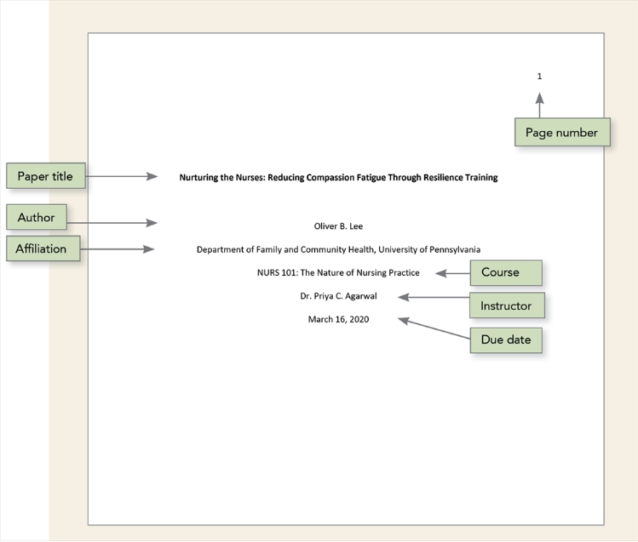
APA Title Page
5
APA distinguishes between professional papers and student papers. The title page shown here is an example for a student course paper.
Note the placement of the following: page number, title, student’s name, institutional affiliation, course information, professor’s name, and the date.
APA, 2.2

Slide 6
In-text (Parenthetical) citations
6
Sevoflurane efficacy is contingent on many variables (Smith, 2008).
(Smith & Jones, 2009)
(Smith, Jones, & Brown, 2010)
(Smith et al., 2012)
(Jones, 2022, p. 17)
APA parenthetical citations pair author last names with years of publication to enable readers to match that content to the source in the alphabetized reference list.
Cite in-text all material that you quote, paraphrase, or summarize.
Each source cited in-text must also appear in the reference list at the end of the paper.
Include page numbers only when quoting directly.
APA, 8.10-8.36

Slide 7

NARRATIVE CITATIONS
7
Narrative citations incorporate author names and publication years into the fabric of sentences.
Hossain (2012) first linked open-source data platforms such as Wikipedia to C.G. Jung’s idea of a collective unconscious.
APA, 8.11

Slide 8
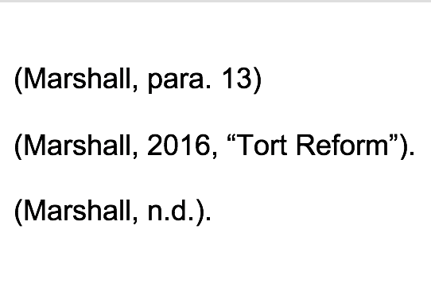
exceptions
8
If an online source is not paginated, use paragraph numbers, or direct readers to the source by its title.
If a source does not have a date, use “no date.”
APA, 9.17

Slide 9
Formatting direct quotations
9
Jansen (2012) noted, “Efficacy of sevoflurane is high in certain established scenarios”(p. 122).
“Efficacy of sevoflurane is high,” one study noted, “in certain established scenarios”(Jansen, 2016, p. 122).
(Jansen, 2016, p. 122)
Use a signal phrase to set up your quote and provide context or attribution.
Quotations may be broken in two.
All in-text citations for direct quotations from paginated sources must include page numbers.
APA, 8.26

Slide 10
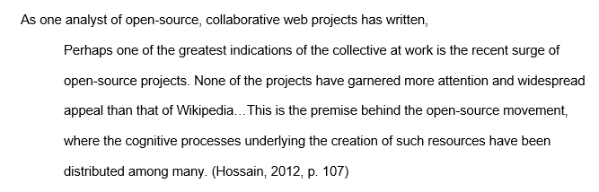
Block quotations
10
If a direct quotation exceeds 40 words in length, format it as a block quote by indenting the entire passage 0.5 inches from the left margin.
Omit quotation marks in block quotations.
As with paraphrase or summary, all block quotes require signal phrases and proper citation at the close of the quotation.
Place the end punctuation at the end of the sentence but before the citation.
APA, 8.27

Slide 11
5 Levels of headings
11
Level 1: Centered, Bold, Title Case Heading
Text begins as a new paragraph.
Level 2: Flush Left, Bold, Title Case Heading
Text begins as a new paragraph.
Level 3: Flush Left, Bold Italic, Title Case Heading
Text begins as a new paragraph
Level 4: Indented, Bold, Title Case Heading, Ending with a Period. Text begins on the same line and continues as a regular paragraph.
Level 5: Indented, Bold Italic, Title Case Heading, Ending with a Period. Text begins on the same line and continues as a regular paragraph.
APA allows 5 levels of headings that act as transitions between sections of a document to convey the overall organization and structure of an argument.
APA, 2.27

Slide 12
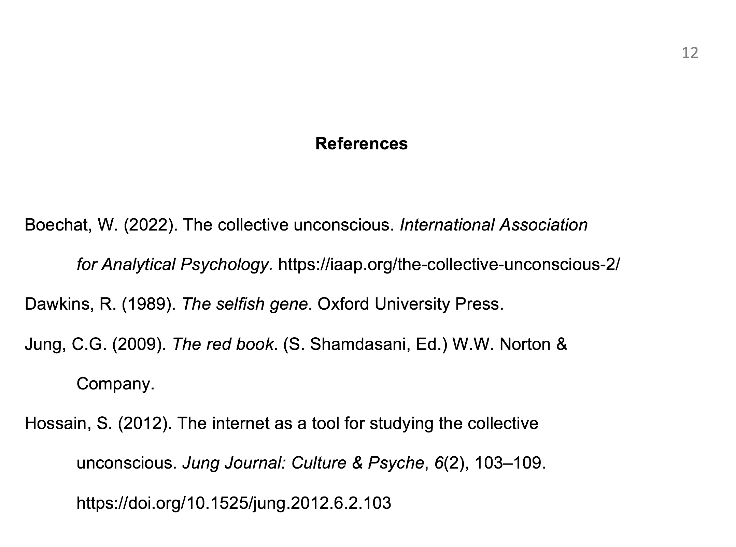
The reference List
12
Begin the reference list on a new page. Alphabetize each entry by author last names.
Begin an entry flush left, but indent subsequent lines by 0.5 inches, for a “hanging indent.”
Each entry should correspond to a citation in the text of the paper.
APA, 2.2-2.24

Slide 13
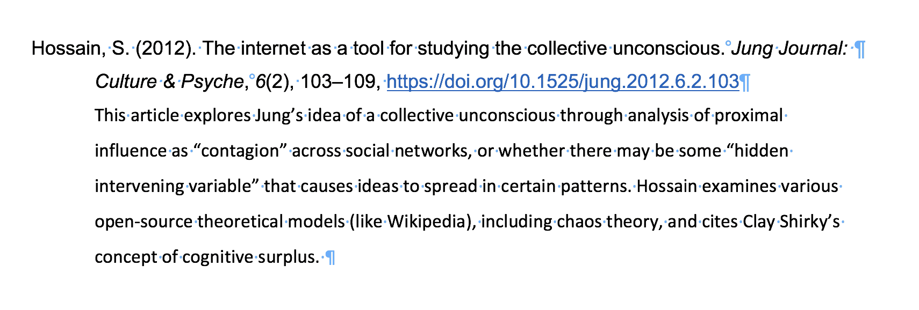
annotations
13
If the assignment requires an annotation, avoid repeating the publication information already included in the entry.
Briefly summarize the source’s main ideas and relevance to your research topic.
Maintain the “hanging indent” of 0.5 inches for the entire annotation.
APA, 9.51

Slide 14
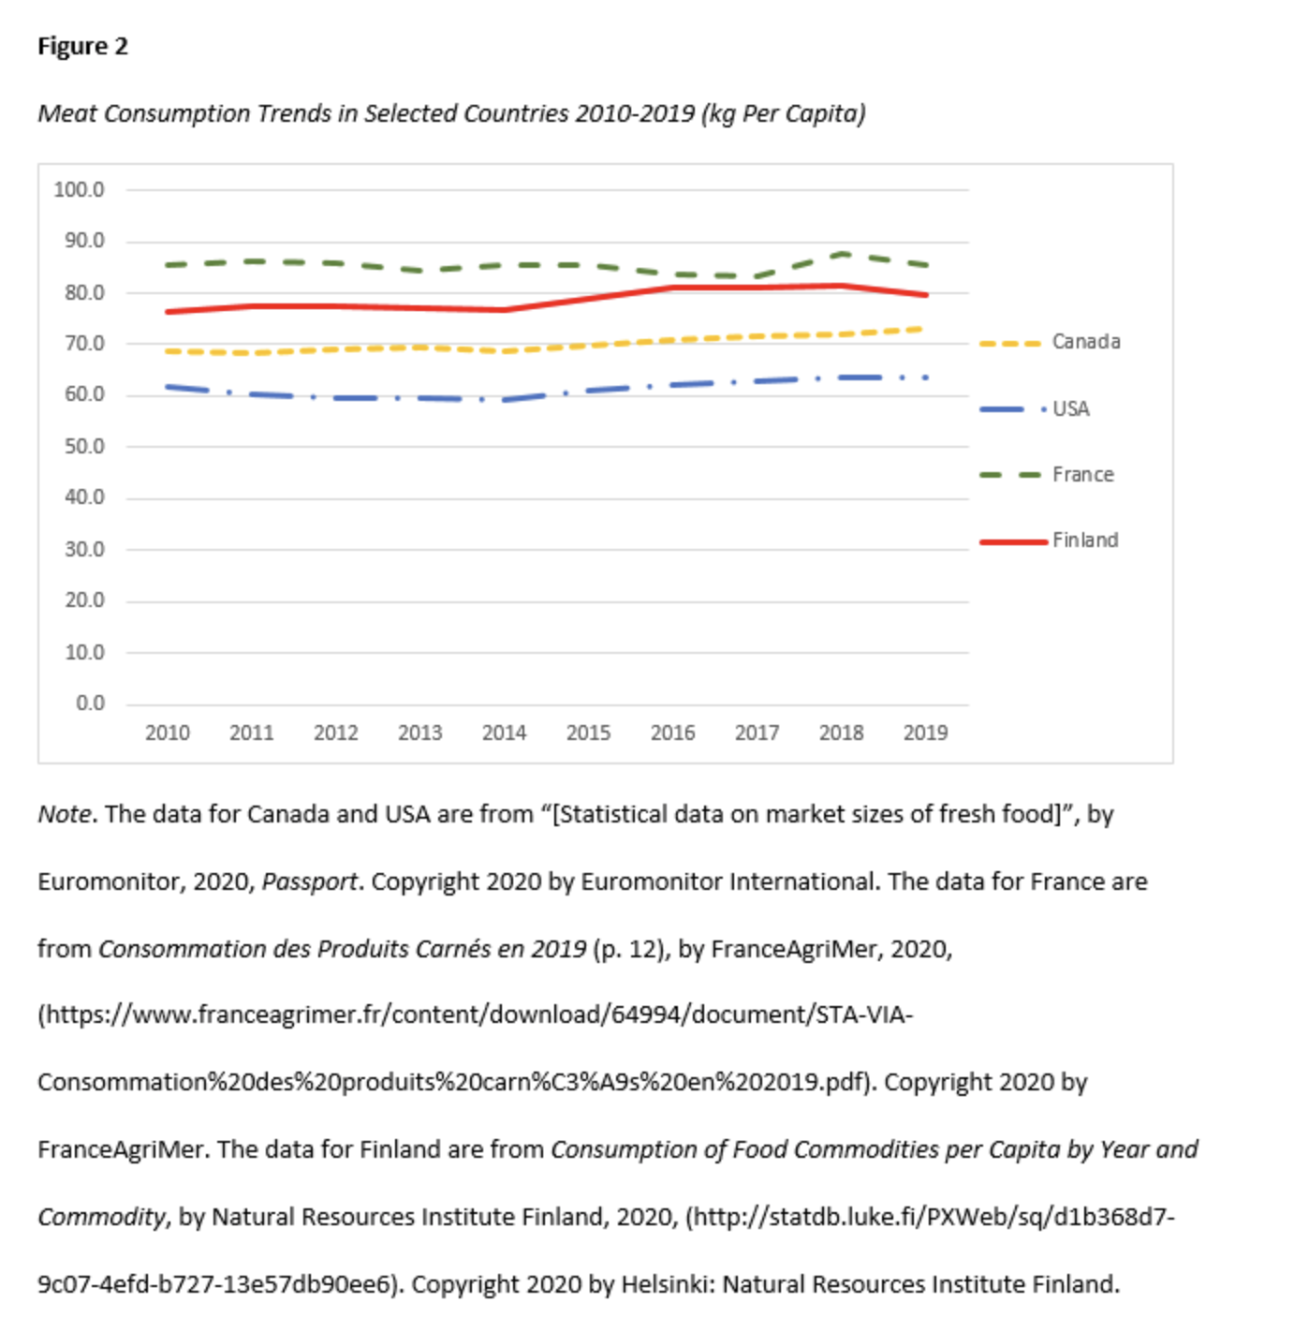
Formatting figures
14
You may place figures (images) at the end of your paper or incorporate them into the text of your paper.
Number all figures sequentially in boldface Arabic numerals, accompanied by a brief, clear title in italics.
If you quote or adapt a figure, acknowledge the source and copyright in a note below.
APA, 7.1-7.21

Slide 15
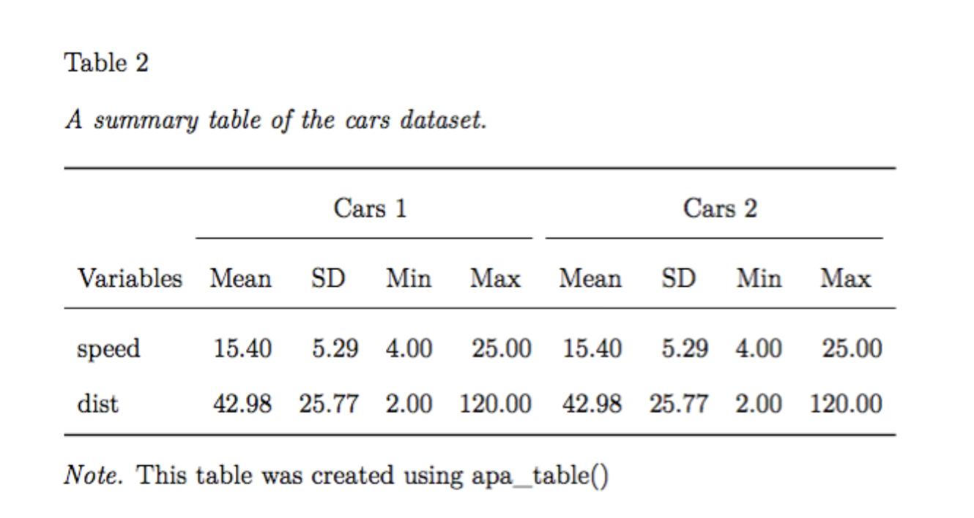
Formatting tables
15
Tables may be placed at the end of your paper or incorporated into your paper.
All tables must be numbered sequentially in boldface Arabic numerals, accompanied by a brief, clear title in italics: Table 3: Cost Analysis.
If you are reproducing or adapting figures or tables using another source, you must acknowledge the copyright of the source in a note below the figure.
APA, 7.1-7.21

Slide 16
Using “callouts”
16
Figure 3 depicts the effects of three random variables on the efficacy of sevoflurane in pediatric use.
For a graphic breakdown of McNair’s 2021 data set, refer to Table 1: Effects of Three Random Variables on Pediatric Efficacy of Sevoflurane.
Do not use directional words such as “above” or “below” to refer to figures or tables in your paper.
Refer to figures and tables only by their numbers and titles. This is known as a “callout.”
Every figure or table included must have a callout in the paper; every callout must correspond to a figure.
APA, 2.13, 7.5

Slide 17
Common apa reference types
APA Publication Manual, 7th edition

Slide 18
Journal article with doi
18
APA, 10.1
Hamer, K., Stamatakis E., & Steptoe, A. (2009). Dose-response relationship between physical activity and
mental health: The Scottish Health Survey. British Journal of Sports Medicine, 43(14),1111-1114.
http://dx.doi.org/10.1136/bjsm.2008.046243
Parenthetical citation: (Hamer et al., 2009)
Narrative citation: Hamer et al. (2009) documented the positive correlation…

Slide 19
Journal article with url
19
APA, 10.1
Parsons, E. (1918). Nativity myth at Laguna and Zuni. Journal of American Folklore, 31(120), 256-263.
https://www.jstor.org/stable/534877
Parenthetical citation: (Parsons, 1918)
Narrative citation: Parsons (1918) documented Zuni nativity myths…

Slide 20
Pubmed journal article
20
Note: APA prefers DOIs to PubMed numbers, but some journals do include them.
APA, 10.1
Liu, G., Lin, Q., Jin, S., & Gao, C. (2022). The CRISPR-Cas toolbox and gene editing
technologies. Molecular Cell, 82(2), 333–347. https://doi.org/10.1016/j.molcel.2021.12.002
Parenthetical citation: (Liu et al., 2022)
Narrative citation: Liu et al. (2022) surveyed current CRISPR-Cas gene editing…

Slide 21
Book with one author (Print)
21
APA, 10.2
Pollan, M. (2006). Omnivore’s dilemma: A natural history of four meals. The Penguin
Press.
Parenthetical citation: (Pollan, 2006)
Narrative citation: Pollan (2006) described “our national eating disorder” and…

Slide 22
E-book from a database
22
APA, 10.2
Nestle, M. (2013). Food politics: How the food industry influences nutrition and health.
University of California Press. http://www.jstor.org/stable/10.1525/j.ctt7zw29z
Parenthetical citation: (Nestle, 2013)
Narrative citation: Nestle (2013) described the “pay for play” trend in…

Slide 23
Book with more than one author
23
APA, 10.2
Woodward, B. & Bernstein, C. (1974). All the president’s men. Simon and Schuster.
Parenthetical citation: (Woodward & Bernstein, 1974)
Narrative citation: Woodward and Bernstein (1974) discussed…

Slide 24
Chapter in an edited book
24
APA, 10.2
Haworth, H. (2019). The fading stars: A constellation. In J. Greenring, (Ed.), Best
American science and nature writing (pp. 99-111). Mariner/Houghton Mifflin Publishing.
Parenthetical citation: (Haworth, 2019)
Narrative citation: Haworth (2019) discusses constellations…

Slide 25
Online magazine article
25
APA, 10.1
Twenge, J. (2017, September 15). Have smartphones destroyed a generation? The Atlantic.
https://www.theatlantic.com/magazine/archive/2017/09/has-the-smartphone-destroyed-a-
generation/534198
Parenthetical citation: (Twenge, 2017)
Narrative citation: Twenge (2017) analyzed social effects of smartphones …

Slide 26
blog post
26
APA, 10.16
Gioia, T. (2022, March 19). The case for super vinyl. The honest broker. Substack.
https://tedgioia.substack.com/p/the-case-for-super-vinyl?s=r
Parenthetical citation: (Gioia, 2022)
Narrative citation: Gioia (2022) argues that music on vinyl is not merely…

Slide 27
article on a WEbsite
27
APA, 10.16
Gotbrath, L. (2022, March 23). What counts as a war crime and why they are so hard to
prosecute. Axios. https://www.axios.com/2022/03/22/russia-putin-war-crimes-icc-
ukraine
Parenthetical citation: (Gotbrath, 2022)
Narrative citation: Gotbrath (2022) maintains…

Slide 28
Website with a retrieval date
28
APA, 10.16
Provide a retrieval date when citing a web-based source whose URL is likely or intended to change. Note: some citation generators provide them automatically whether necessary or not.
Centers for Disease Control. (2022, March 9). Self-testing at home or anywhere.
Retrieved on June 10, 2022, from https://www.cdc.gov/coronavirus/2019-ncov/testing/self-testing.html
Parenthetical citation first mention: (Centers for Disease Control [CDC], 2022)
Narrative citation first mention: The Centers for Disease Control (2022) issued guidance regarding…
  Later mentions for Parenthetical citations regarding acronyms: (CDC, 2022)
  Later mentions for Narrative citations regarding acronyms: CDC (2022) explained…

Slide 29
Online newspaper article
29
APA, 10.1
Blow, C. (2022, June 8). America’s ‘psychic numbing’ to gun violence. The New York Times.
https://www.nytimes.com/2022/06/08/opinion/numbing-gun-violence.html
Parenthetical citation: (Blow, 2022)
Narrative citation: Blow (2022) notes as we become desensitized to…

Slide 30
dictionary or encyclopedia online
30
APA, 10.3
Merriam-Webster. (n.d.). Trauma. In Merriam-Webster.com dictionary. Retrieved June 13, 2022, from
https://www.merriam-webster.com/dictionary/trauma
Parenthetical citation: (Merriam-Webster, n.d.)
Narrative citation: The current Merriam-Webster (n.d.) definition of “trauma” includes……

Slide 31
Agency or group-authored report
31
APA, 10.4.51
UNESCO World Water Assessment Programme. (2022). The United Nations world water development
report 2022: Groundwater: Making the invisible visible. https://unesdoc.unesco.org/ark:/
48223/pf0000380721
Parenthetical citation first mention: (United Nations Educational, Scientific, and Cultural Organization [UNESCO] World Water Assessment Programme, 2022)
Narrative citation first mention: The United Nations Educational, Scientific, and Cultural Organization (UNESCO) World Water Assessment Programme (2022) issued guidance regarding…
  Later mentions for Parenthetical citations regarding acronyms: (UNESCO World Water Assessment Programme, 2022)
  Later mentions for Narrative citations regarding acronyms: The UNESCO World Water Assessment Programme (2022) explained…

Slide 32
Film or video
32
APA, 10.12
Orlowsky-Yang, J. (Director). (2020). The social dilemma [Film]. Exposure Labs.
Parenthetical citation: (Orlowsky-Yang, 2020)
Narrative citation: Orlowsky-Yang (2020) analyzed social media…

Slide 33
YouTube or streaming video
33
APA, 10.12.90
United Nations. (2021, April 21). Climate change for kids [Video]. YouTube.
https://www.youtube.com/watch?v=WkvPdUtYhX8
Parenthetical citation: (United Nations, 2021)
Narrative citation: The United Nations (2021) clarified its position in its film for children…

Slide 34
Song or track on an album
34
APA, 10.13
Anderson, L. (1981). O Superman [Song]. On Big science. Warner Bros. Records.
Parenthetical citation: (Anderson, 1982)
Narrative citation: Anderson’s O Superman (1981) captured the decade’s…

Slide 35
Podcast episode
35
APA, 10.13
Winfrey, O. (Host). (2020, Sept. 16) Beyonce. (No. 290) [Audio podcast episode]. In Oprah’s Super Soul.
Harpo Productions. https://super-soul.simplecast.com/episodes/beyonce-JxZiHEvg
Parenthetical citation: (Winfrey, 2020)
Narrative citation: Winfrey (2020) discussed strategies for building resilience in her podcast episode.

Slide 36
Ted talk / webinar
36
APA, 10.12.88
Gates, B. (2022, April 22). We can make COVID the last pandemic [Video]. TED
Conferences. https://www.ted.com/talks/bill_gates_we_can_make_covid_19_the_last_pandemic
Parenthetical citation: (Gates, 2022)
Narrative citation: Gates (2022) proposed to end the current pandemic by…

Slide 37
Radio broadcast
37
APA, 10.13
Nelson, D., & Silva, N. (2018, September 26). The keepers of the underground: The hip-hop archive
at Harvard [Radio broadcast]. NPR. https://www.npr.org/people/5252035/the-kitchen-sisters
Parenthetical citation: (Nelson & Silva, 2018)
Narrative citation: Nelson and Silva (2018) devoted a radio broadcast to Harvard’s hip-hop archive…

Slide 38
PowerPoint from a class website
38
APA, 10.14
Sanders, C. (2021, March 21). Modernization and its discontents: Europe in 1789. [PowerPoint
slides]. Brightspace@TCU. https://tcu.brightspace.com/d2l/home
Parenthetical citation: (Sanders, 2021)
Narrative citation: Sanders (2021) made the case that modernization was…

Slide 39
Federal statute
39
APA, 11.5
Lilly Ledbetter Fair Pay Act of 2009, pub L. no. 111-2, 123 Stat. 5 § 2 (2009). https://www.congress.gov/111/plaws/publ2/PLAW-111publ2.pdf
Parenthetical citation: (Lilly Ledbetter Fair Pay Act, 2009)
Narrative citation: The Lilly Ledbetter Fair Pay Act (2009)…

Slide 40
Supreme court decision
40
APA, 11.1
Brown v. Board of Education, 347 U.S. 483 (1954).
https://www.oyez.org/cases/1940-1955/347us483
Parenthetical citation: (Brown v. Board of Education, 1954)
Narrative citation: Brown v. Board of Education (1954) was a pivotal moment…

