Slide 1


APA style guide
©️ 2026 W.L. Adams Center for Writing/Texas Christian University

Slide 2
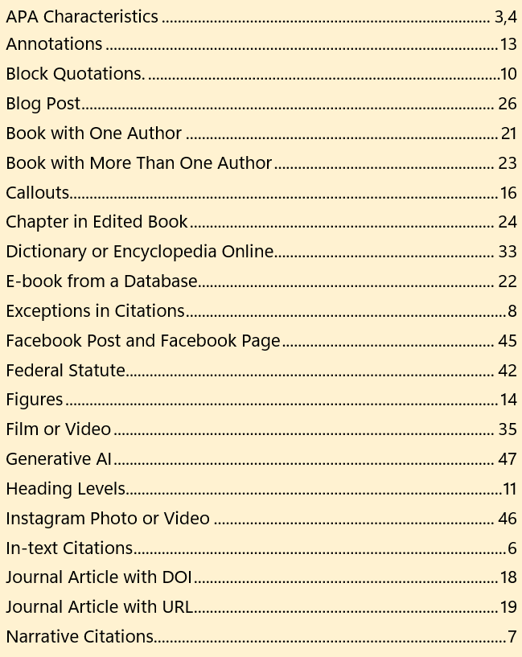
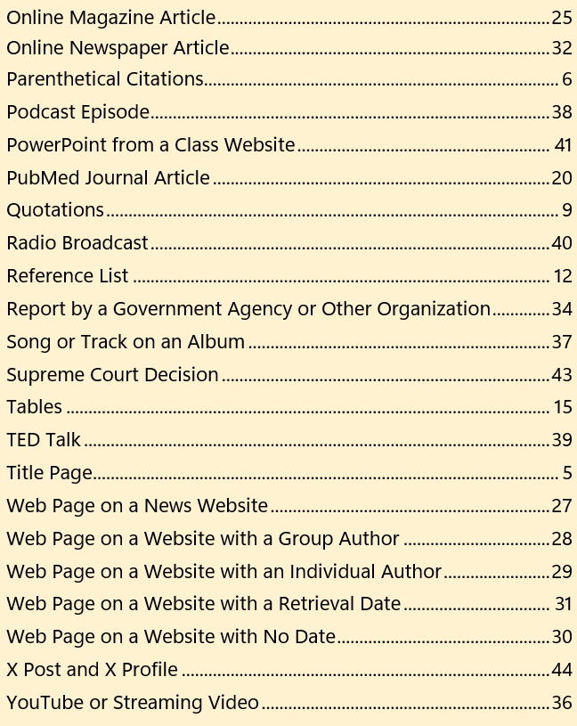
Index
2

Slide 3
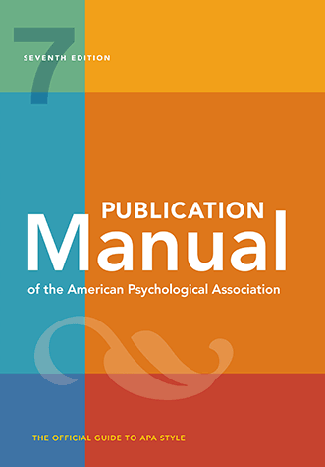
What is APA style?
3
APA Style refers to a system of documentation used by the American Psychological Association.
APA Style is often a requirement of research essays and course papers written in the sciences, medical fields, and business.
APA Style emphasizes the names of researchers and how current the research is by including authors and years in parenthetical citations: (Hart, 2016).

Slide 4
Key characteristics
4
A separate title page
A 12-point, serif font, such as Times New Roman, or sans serif font, such as Arial
Parenthetical citations that emphasize author and timeliness: (Smith, 2020)
Page numbers cited only with direct quotations
Block quotes of 40+ words
”Sentence case rules” for capitalization of article and book titles

Slide 5
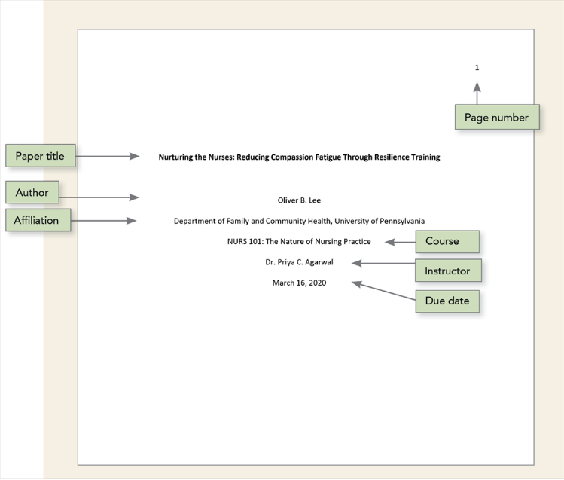
Title Page
5
APA distinguishes between professional papers and student papers. The title page shown here is an example for a student course paper.
Note the placement of the following: the page number, title, student’s name, institutional affiliation, course information, professor’s name, and date.
APA, 2.2

Slide 6
In-text (Parenthetical) citations
6
Sevoflurane efficacy is contingent on many variables (Smith, 2008).
(Smith & Jones, 2009)
(Fields et al., 2012)
(Jacobs, 2022, p. 17)
APA parenthetical citations pair author last names with years of publication to enable readers to match that content to the source in the alphabetized reference list.
Cite in-text all material that you quote, paraphrase, or summarize.
Each source cited in-text must also appear in the reference list at the end of the paper.
Include page numbers only when quoting directly.
APA, 8.10-8.36

Slide 7

NARRATIVE CITATIONS
7
Narrative citations incorporate author names and publication years into the fabric of sentences.
Hossain (2012) first linked open-source data platforms such as Wikipedia to C.G. Jung’s idea of a collective unconscious.
APA, 8.11

Slide 8
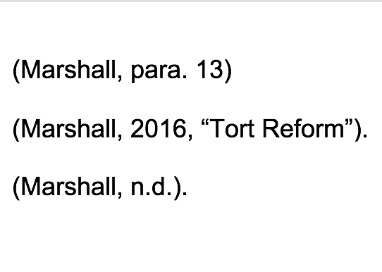
exceptions in citations
8
If an online source is not paginated, use paragraph numbers, or direct readers to the source by its title.
If a source does not have a date, use “no date.”
APA, 9.17

Slide 9
quotations
9
Jansen (2012) noted, “Efficacy of sevoflurane is high in certain established scenarios”(p. 122).
“Efficacy of sevoflurane is high,” one study noted, “in certain established scenarios”(Jansen, 2016, p. 122).
(Jansen, 2016, p. 122)
Use a signal phrase to set up your quote and provide context or attribution.
Quotations may be broken in two.
All in-text citations for direct quotations from paginated sources must include page numbers.
APA, 8.26

Slide 10
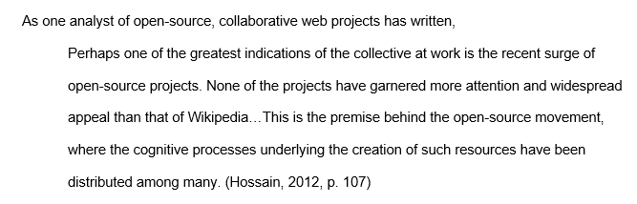
Block quotations
10
If a direct quotation exceeds forty words in length, format it as a block quote by indenting the entire passage 0.5 inches from the left margin and ensure it is double-spaced.
Do not add quotation marks in block quotations.
As with paraphrase or summary, all block quotes require signal phrases and proper citation at the close of the quotation.
Place the end punctuation at the end of the sentence but before the citation.
APA, 8.27

Slide 11
heading Levels
11
Level 1: Centered, Bold, Title Case Heading
Text begins as a new paragraph.
Level 2: Flush Left, Bold, Title Case Heading
Text begins as a new paragraph.
Level 3: Flush Left, Bold Italic, Title Case Heading
Text begins as a new paragraph
Level 4: Indented, Bold, Title Case Heading, Ending with a Period. Text begins on the same line and continues as a regular paragraph.
Level 5: Indented, Bold Italic, Title Case Heading, Ending with a Period. Text begins on the same line and continues as a regular paragraph.
APA allows 5 levels of headings that act as transitions between sections of a document to convey the overall organization and structure of an argument.
APA, 2.27

Slide 12
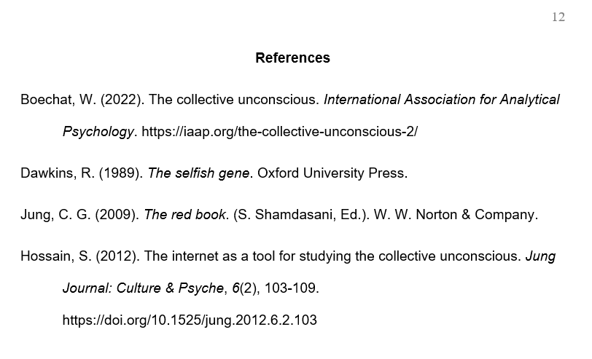
reference List
12
Begin the reference list on a new page. Alphabetize each entry by author last names.
Begin an entry flush left, but indent subsequent lines by 0.5 inches, for a “hanging indent.”
Each entry should correspond to a citation in the text of the paper.
APA, 2.2-2.24

Slide 13
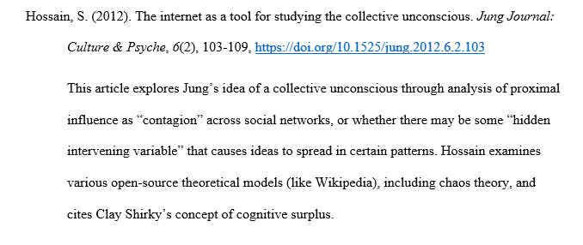
annotations
13
If the assignment requires an annotation, avoid repeating the publication information already included in the entry.
Briefly summarize the source’s main ideas and relevance to your research topic.
Maintain the “hanging indent” of 0.5 inches for the entire annotation and ensure the annotation and summary paragraph are double-spaced with no separating space between them.
APA, 9.51

Slide 14
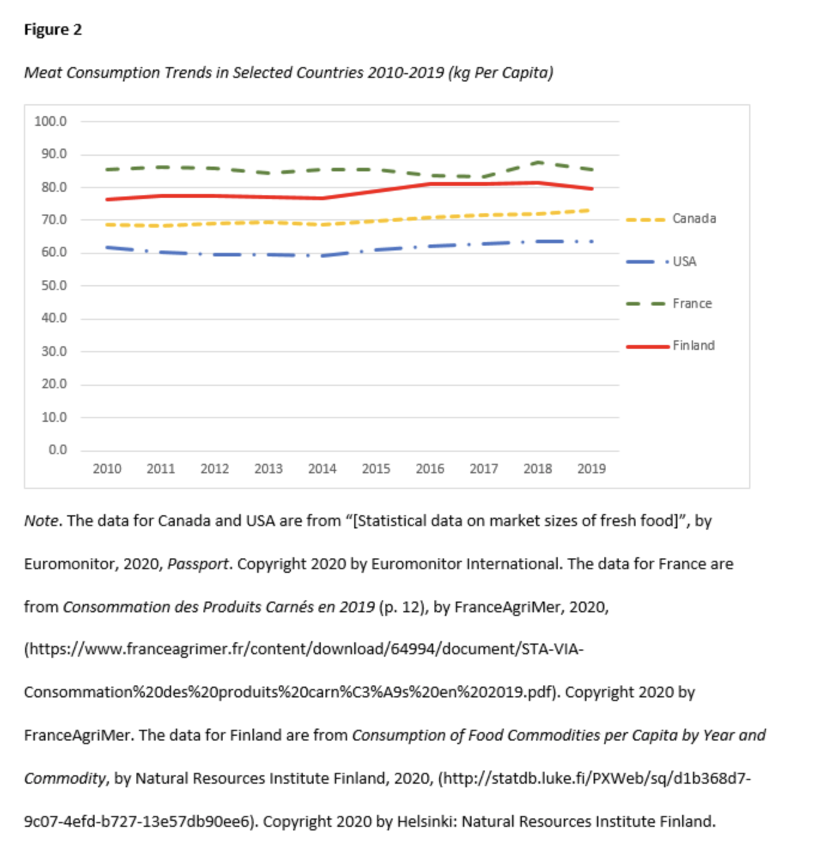
figures
14
You may place figures (images) at the end of your paper or incorporate them into the text of your paper.
Number all figures sequentially in boldface Arabic numerals, accompanied by a brief, clear title in italics.
If you quote or adapt a figure, acknowledge the source and copyright in a note below.
APA, 7.1-7.21

Slide 15
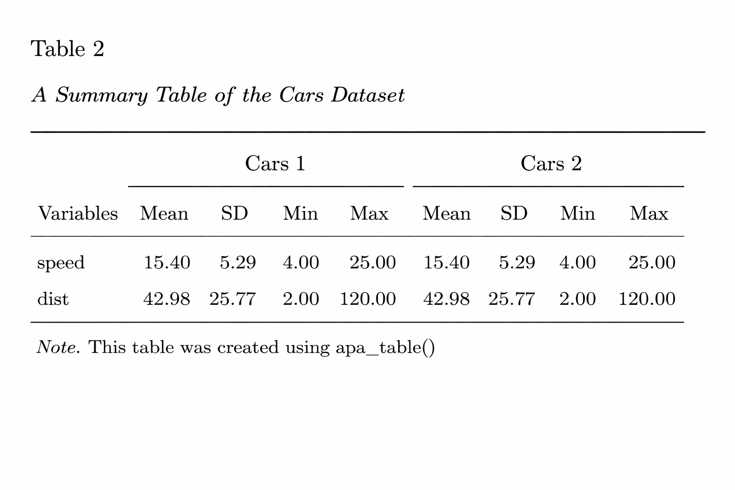
tables
15
Tables may be placed at the end of your paper or incorporated into your paper.
All tables must be numbered sequentially in boldface Arabic numerals, accompanied by a brief, clear title in italics: Table 3: Cost Analysis.
If you are reproducing or adapting figures or tables using another source, you must acknowledge the copyright of the source in a note below the figure.
APA, 7.1-7.21

Slide 16
callouts
16
Figure 3 depicts the effects of three random variables on the efficacy of sevoflurane in pediatric use.
For a graphic breakdown of McNair’s 2021 data set, refer to Table 1: Effects of Three Random Variables on Pediatric Efficacy of Sevoflurane.
Refer to figures and tables only by their numbers and titles. This attribution is known as a “callout.”
Do not use directional words such as “above” or “below” to refer to figures or tables in your paper.
Every figure or table included must have a callout in the paper; every callout must correspond to a figure.
APA, 2.13, 7.5

Slide 17
Common apa reference types
APA Publication Manual, 7th edition

Slide 18
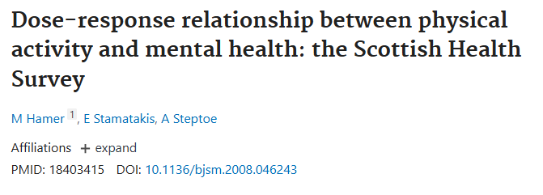
Journal article with doi
18
Hamer, K., Stamatakis E., & Steptoe, A. (2009). Dose-response relationship between physical activity and
mental health: The Scottish Health Survey. British Journal of Sports Medicine, 43(14),1111-1114.
http://dx.doi.org/10.1136/bjsm.2008.046243
Parenthetical citation: (Hamer et al., 2009)
Narrative citation: Hamer et al. (2009) documented the positive correlation…
APA, 10.1

Slide 19
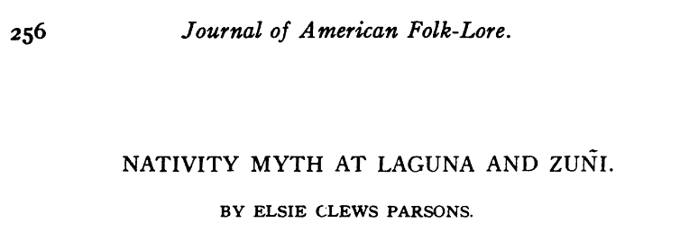
Journal article with url
19
Parsons, E. (1918). Nativity myth at Laguna and Zuni. Journal of American Folklore, 31(120), 256-263.
https://www.jstor.org/stable/534877
Parenthetical citation: (Parsons, 1918)
Narrative citation: Parsons (1918) documented Zuni nativity myths…
APA, 10.1

Slide 20

Pubmed journal article
20
Note: APA prefers DOIs to PubMed numbers, but some journals do include them.
Liu, G., Lin, Q., Jin, S., & Gao, C. (2022). The CRISPR-Cas toolbox and gene editing technologies.
Molecular Cell, 82(2), 333–347. https://doi.org/10.1016/j.molcel.2021.12.002
Parenthetical citation: (Liu et al., 2022)
Narrative citation: Liu et al. (2022) surveyed current CRISPR-Cas gene editing…
APA, 10.1

Slide 21
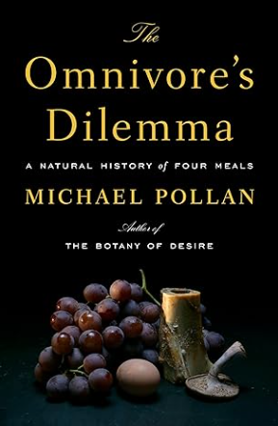
Book with one author (Print)
21
Pollan, M. (2006). Omnivore’s dilemma: A natural history of four meals. The Penguin Press.
Parenthetical citation: (Pollan, 2006)
Narrative citation: Pollan (2006) described “our national eating disorder” and… (p. 81).
APA, 10.2

Slide 22

E-book from a database
22
Nestle, M. (2013). Food politics: How the food industry influences nutrition and health.
University of California Press. http://www.jstor.org/stable/10.1525/j.ctt7zw29z
Parenthetical citation: (Nestle, 2013)
Narrative citation: Nestle (2013) described the "pay for play" trend in…
APA, 10.2

Slide 23
Book with more than one author
23
Woodward, B. & Bernstein, C. (1974). All the president’s men. Simon and Schuster.
Parenthetical citation: (Woodward & Bernstein, 1974)
Narrative citation: Woodward and Bernstein (1974) discussed…
APA, 10.2

Slide 24
Chapter in an edited book
24
Haworth, H. (2019). The fading stars: A constellation. In J. Greenring, (Ed.), Best
American science and nature writing (pp. 99-111). Mariner/Houghton Mifflin Publishing.
Parenthetical citation: (Haworth, 2019)
Narrative citation: Haworth (2019) discusses constellations…
APA, 10.2

Slide 25
Online magazine article
25
Twenge, J. (2017, September 15). Have smartphones destroyed a generation? The Atlantic.
https://www.theatlantic.com/magazine/archive/2017/09/has-the-smartphone-destroyed-a-
generation/534198
Parenthetical citation: (Twenge, 2017)
Narrative citation: Twenge (2017) analyzed social effects of smartphones…
APA, 10.1

Slide 26
blog post
26
Gioia, T. (2022, March 19). The case for super vinyl. The honest broker. Substack.
https://tedgioia.substack.com/p/the-case-for-super-vinyl?s=r
Parenthetical citation: (Gioia, 2022)
Narrative citation: Gioia (2022) argues that music on vinyl is not merely…
APA, 10.16

Slide 27
WEb page on a news website
27
Avramova, N. (2019, January 3). The secret to a long, happy, healthy life? Think age-positive. CNN.
https://www.cnn.com/2019/01/03/health/respect-toward-elderly-leads-to-long-life-intl/index.html
Parenthetical citation: (Avramova, 2019)
Narrative citation: Avramova (2019) details…
APA, 10.16

Slide 28
Web page on a website with a group author
28
Centers for Disease Control and Prevention. (2018, January 23). People at high risk of developing flu-related
complications. https://www.cdc.gov/flu/about/disease/high_risk.htm
Parenthetical citation first mention: (Centers for Disease Control and Prevention, 2018)
Narrative citation first mention: Centers for Disease Control and Prevention (2018)
  When the author and site name are the same, omit the site name from the source element.
APA, 10.16

Slide 29
Web page on a website with an individual author
29
Martin Lillie, C. M. (2016, December 29). Be kind to yourself: How self-compassion can improve your
resiliency. Mayo Clinic. https://www.mayoclinic.org/healthy-lifestyle/adult-health/in-depth/self
compassion-can-improve-your-resiliency/art-20267193
Parenthetical citation: (Martin Lillie, 2016)
Narrative citation: Martin Lillie (2016) argues...
APA, 10.16

Slide 30
Web page on a website with No Date
30
Boddy, J., Neumann, T., Jennings, S., Morrow, V., Alderson, P., Rees, R., & Gibson, W. (n.d.). Ethics
principles. The Research Ethics Guidebook: A Resource for Social Scientists.
https://www.ethicsguidebook.ac.uk/EthicsPrinciples
Parenthetical citation: (Boddy et al., n.d.)
Narrative citation: Boddy et al. (n.d.) asserts...
APA, 10.16

Slide 31
Web page on a website with a retrieval date
31
Provide a retrieval date when citing a web-based source whose URL is likely or intended to change. Note: some citation generators provide them automatically whether necessary or not.
U.S. Census Bureau. (n.d.). U.S. and world population clock. U.S. Department of Commerce. Retrieved July 3, 2019, from
https://www.census.gov/popclock
Parenthetical citation first mention: (U.S. Census Bureau, n.d.)
Narrative citation first mention: The U.S. Census Bureau (n.d.) stated…
APA, 10.16

Slide 32
Online newspaper article
32
Blow, C. (2022, June 8). America’s ‘psychic numbing’ to gun violence. The New York
Times. https://www.nytimes.com/2022/06/08/opinion/numbing-gun-violence.html
Parenthetical citation: (Blow, 2022)
Narrative citation: Blow (2022) notes as we become desensitized to…
APA, 10.1

Slide 33
dictionary or encyclopedia online
33
Merriam-Webster. (n.d.). Trauma. In Merriam-Webster.com dictionary. Retrieved June 13, 2022, from
https://www.merriam-webster.com/dictionary/trauma
Parenthetical citation: (Merriam-Webster, n.d.)
Narrative citation: The current Merriam-Webster (n.d.) definition of “trauma” includes……
APA, 10.3

Slide 34
Report by a government agency or other organization
34
APA, 10.4
Canada Council for the Arts. (2013). What we heard: Summary of key findings: 2013 Canada Council's
Inter-Arts Office consultation. https://publications.gc.ca/collections/collection_2017/canadacouncil/K23-65
2013-eng.pdf
Parenthetical citation first mention: (Canada Council for the Arts, 2013)
Narrative citation first mention: The Canada Council for the Arts (2013) explains that...

Slide 35
Film or video
35
Orlowsky-Yang, J. (Director). (2020). The social dilemma [Film]. Exposure Labs.
Parenthetical citation: (Orlowsky-Yang, 2020)
Narrative citation: Orlowsky-Yang (2020) analyzed social media…
APA, 10.12

Slide 36
YouTube or streaming video
36
United Nations. (2021, April 21). Climate change for kids [Video]. YouTube.
https://www.youtube.com/watch?v=WkvPdUtYhX8
Parenthetical citation: (United Nations, 2021)
Narrative citation: The United Nations (2021) clarified its position in its film for children…
APA, 10.12.90

Slide 37
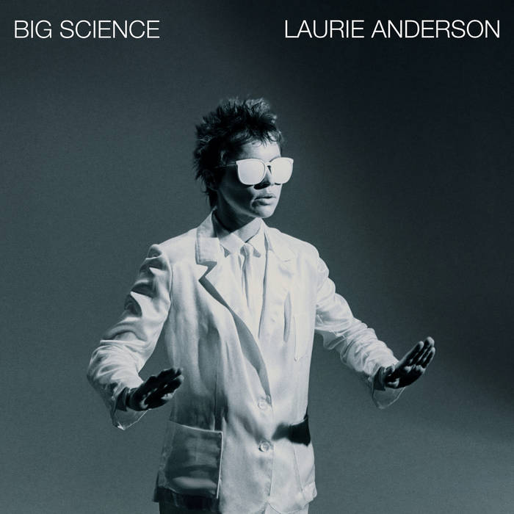
Song or track on an album
37
Anderson, L. (1981). O Superman [Song]. On Big science. Warner Bros. Records.
Parenthetical citation: (Anderson, 1981)
Narrative citation: Anderson’s O Superman (1981) captured the decade’s…
APA, 10.13

Slide 38
Podcast episode
38
Winfrey, O. (Host). (2020, Sept. 16) Beyoncé. (No. 290) [Audio podcast episode]. In Oprah’s Super Soul.
Harpo Productions. https://goodpods.com/podcasts/oprahs-super-soul-11622/beyonc%C3%A9-7032683
Parenthetical citation: (Winfrey, 2020)
Narrative citation: Winfrey (2020) discussed strategies…
APA, 10.13

Slide 39
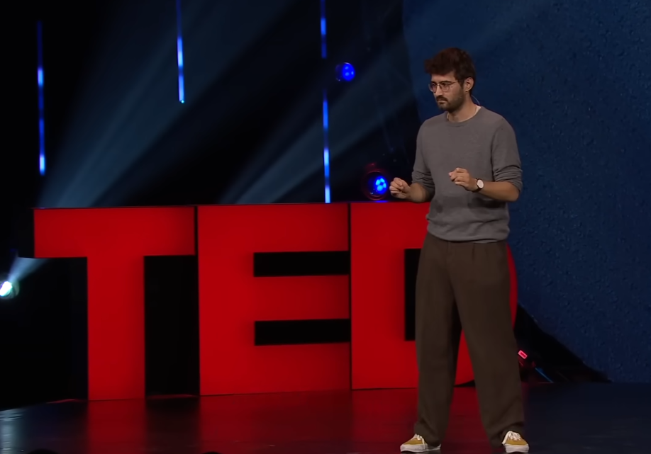
Ted talk
39
Aleksic, A. (2025, November). Why are people starting to sound like ChatGPT? [Video]. TED
Conferences. https://www.ted.com/talks/adam_aleksic_why_are_people_starting_to_sound_like_chatgpt
Parenthetical citation: (Aleksic, 2025)
Narrative citation: Aleksic (2025) explains…
APA, 10.12.88

Slide 40
Radio broadcast
40
Nelson, D., & Silva, N. (2018, September 26). The keepers of the underground: The hip-hop archive
at Harvard [Radio broadcast]. NPR. https://www.npr.org/people/5252035/the-kitchen-sisters
Parenthetical citation: (Nelson & Silva, 2018)
Narrative citation: Nelson and Silva (2018) devoted a radio broadcast to…
APA, 10.13

Slide 41
PowerPoint from a class website
41
Sanders, C. (2021, March 21). Modernization and its discontents: Europe in 1789. [PowerPoint
slides]. Brightspace@TCU. https://tcu.brightspace.com/d2l/home
Parenthetical citation: (Sanders, 2021)
Narrative citation: Sanders (2021) made the case that modernization was…
APA, 10.14

Slide 42
Federal statute
42
Lilly Ledbetter Fair Pay Act of 2009, Pub L. No. 111-2, 123 Stat. 5 (2009).
https://www.congress.gov/111/plaws/publ2/PLAW-111publ2.pdf
Parenthetical citation: (Lilly Ledbetter Fair Pay Act, 2009)
Narrative citation: The Lilly Ledbetter Fair Pay Act (2009)…
APA, 11.5

Slide 43
Supreme court decision
43
Brown v. Board of Education, 347 U.S. 483 (1954). https://www.oyez.org/cases/1940-1955/347us483
Parenthetical citation: (Brown v. Board of Education, 1954)
Narrative citation: Brown v. Board of Education (1954) was a pivotal moment…
APA, 11.1

Slide 44

X Post and x profile
44
https://apastyle.apa.org/style-grammar-guidelines/references/examples/x-references
X Post
APA Databases [@APA_Databases]. (2020, September 2). We have curated a collection of journal articles from
APA PsycArticles on #COVID19. View: https://bit.ly/2QrWj76 for recent coverage [Image attached] [Post]. X.
https://x.com/APA_Databases/status/1301175576703664128
Parenthetical citation: (APA Databases, 2020)
Narrative citation: APA Databases (2020) provide…
X Profile
Jordan, M. B. [@michaelb4jordan]. (n.d.). Replies [X profile]. X. Retrieved January 9, 2020, from
https://x.com/michaelb4jordan/with_replies
Parenthetical citation: (Jordan, n.d.)
Narrative citation: Jordan (n.d.) comments that…

Slide 45

Facebook Post and Facebook page
45
Facebook Post
Gaiman, N. (2018, March 22). 100,000+ Rohingya refugees could be at serious risk during Bangladesh's
monsoon season. My fellow UNHCR Goodwill Ambassador Cate Blanchett is [Image attached] [Status
update]. Facebook. http://bit.ly/2JQxPAD
Parenthetical citation: (Gaiman, 2018)
Narrative citation: Gaiman (2018) notes…
Facebook Page
Smithsonian's National Zoo and Conservation Biology Institute. (n.d.) Home [Facebook page]. Facebook.
Retrieved July 22, 2019, from https://www.facebook.com/nationalzoo
Parenthetical citation: (Smithsonian's National Zoo and Conservation Biology Institute, n.d.)
Narrative citation: Smithsonian's National Zoo and Conservation Biology Institute (n.d.) explains…
APA, 10.15

Slide 46

Instagram Photo or video
46
Zeitz MOCAA [zeitzmocaa]. (2018, November 26). Grade 6 learners from Parkfields
Primary School in Hanover Park visited the museum for a tour and workshop
hosted by [Photographs]. Instagram. https://www.instagram.com/p/BqpHpjFBs3b/
Parenthetical citation: (Zeitz MOCAA, 2018)
Narrative citation: In a photo uploaded by Zeitz MOCAA (2018)…
APA, 10.15

Slide 47

Generative Ai
47
General AI Chat Citation
OpenAI. (2026). ChatGPT [Large language model]. https://chat.openai.com/
Parenthetical citation: (OpenAI, 2026)
Narrative citation: OpenAI (2026) describes…
Specific AI Chat Citation
OpenAI. (2026, January 8). Response to the prompt "In 200 words, describe the symbolism of
the ruined statue in Ozymandias" [Generative AI chat]. ChatGPT. https://chat.openai.com/
Parenthetical citation: (OpenAI, 2026)
Narrative citation: When prompted with "In 200 words, describe the symbolism of the
ruined statue in Ozymandias" ChatGPT stated that the ruined statue
symbolizes "the passage of time and the inevitable loss of power
associated with it" (OpenAI, 2026).
https://apastyle.apa.org/blog/how-to-cite-chatgpt
https://apastyle.apa.org/blog/cite-generative-ai-references

